Slide 1
Reinventing urban waterways: the evolution of new values for old ditches
Nicki Schiessel Harvey
Birmingham City University
UK Ireland Planning Conference, 9th September 2021
nicki.schiesselharvey@bcu.ac.uk https://www.linkedin.com/in/nickischiesselharvey/

Slide 2
Birmingham present: What is an urban canal for?

Slide 3
Birmingham past: What is an urban canal for?
Notes:
https://www.expressandstar.com/entertainment/2015/10/20/the-regeneration-of-birminghams-canalside/

Slide 4
Birmingham present: What is an urban canal for?

Slide 5
In the next 10 minutes….
The transition process from disused ditch to wellbeing asset
Some of the many influences on the evolution
Aspects of research tackling the evidence-policy loop
Early considerations for planners

Slide 6
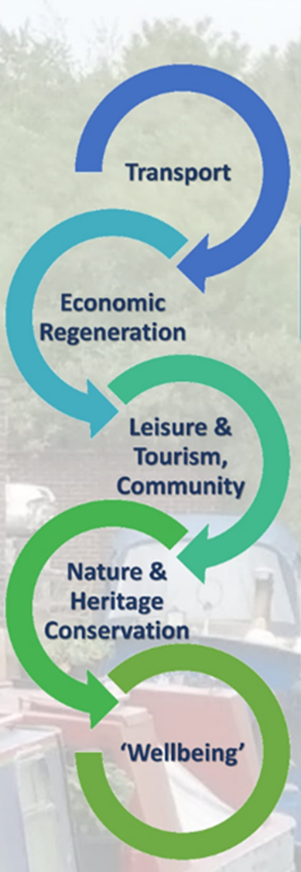
Focus: values, evidence & policy change
Proposition – key ‘change points’ in evidence have influenced the public and policy narratives around inland waterways. These in turn generate demands for new evidence to support and influence policy agendas
Policy change theory informs historical and contemporary analysis of inland waterway evidence use and policy change. Thematic documentary analysis & case studies

Slide 7
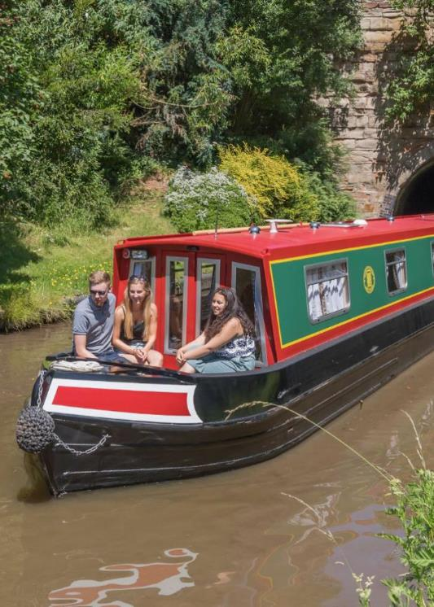
Evolution of the ‘purpose’ of a waterway

Slide 8
2000s: The National Lottery & other new funders
Evidence production to meet funding criteria
Big projects changed the way canals are seen – benefits began to be made explicit

Slide 9
Canal & River Trust Context
British Waterways became a Charity in 2012
Owns & operates ~2000 miles of inland waterways in England
~£50m pa Defra Grant (25% of income), currently being reviewed
2018 rebrand to a Waterways & Wellbeing charity
Extensive evidence programme to support change of public focus
But why wellbeing as the focus?

Slide 10
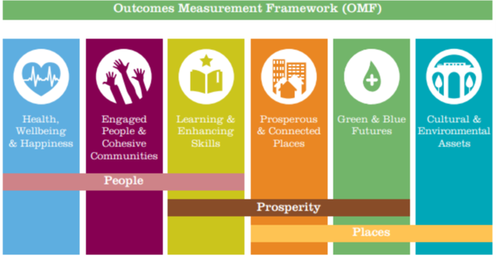
Aligning interests or jumping bandwagons?
Policy awareness of long term health costs, esp in areas of deprivation
Growing evidence base on value of greenspace/ nature and wellbeing – in Treasury language
Awareness of opportunities
Local Partnerships
Covid – emphasised local

Slide 11
Opportunities for wider thinking about water
Broader evidence addressing wider range of benefits highlights opportunities to integrate urban waterways into development.
New ideas now >> new evidence (?) >> new policy and new partnerships
Waterways as ‘public goods’. Who pays, who benefits, long and short term?
*Example document – author not associated with this project

Slide 12
Comments & thoughts?

