Slide 1
Thoughts on the future of IoT security assurance and certification
Paul Kearney Professor of Cybersecurity (part time)

Slide 2
Outline of talk
IoT Security Foundation
Product security assurance and certification
What’s wrong at the moment?
Some thoughts on how to make certification work
If not certification, then what?

Slide 3

IoT Security Foundation
https://www.iotsecurityfoundation.org/
A non-profit, member-driven, collaborative, vendor-neutral, international initiative. Sister organisation of AESIN in TechWorks.
Mission:
Help secure the Internet of Things and make it safe to connect.
By means of:
A comprehensive Assurance Framework for creating secure IoT products and services,
Promoting the adoption and supporting the use of the Assurance Framework,
Publishing and promoting security best practice guidance
Organisation:
Work done by members in working groups
Each WG hosts one or more projects at any time
Share information in plenary meetings
Overseen by Executive steering board.

Slide 4
Assurance and certification
Assurance:
Gaining confidence that the security properties of the product meet the requirements for a particular customer deployment
Are the properties claimed for the product by the vendor adequate/appropriate?
Are the vendor’s claims really true?
Requirements include assumptions about threat, technical and business context
Assurance level reflects the depth and rigor of the evaluation
Certification:
Generally dealing with a class of products and/or application settings
Often distinguish graduated levels of security requirement (e.g. High, Medium, Low)
Trusted authority:
Defines typical requirements within class (protection profile)
Defines evaluation process and approves ‘labs’
Issues certificates to product types if evaluation successful.

Slide 5



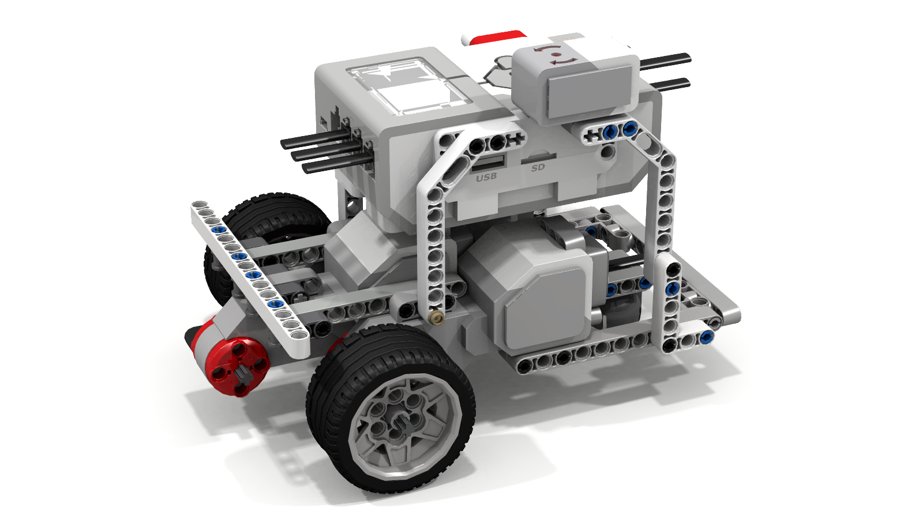
Three stakeholder perspectives
Regulator / industry body
Product
This Photo by Unknown Author is licensed under CC BY-SA-NC
This Photo by Unknown Author is licensed under CC BY
Manufacturer/ supplier
Customer/ end-user
This Photo by Unknown Author is licensed under CC BY-SA-NC
Target of evaluation (ToE)
Knows:
Doesn’t know
Innards of product
About security
Where, for what and how the product will be used
Wants to know:
Which product to buy
How to use it securely
Knows:
Doesn’t know
All about the product
Wants to know:
Product is secure enough for its market?
Limitations on secure usage
Usage environment
About security

Slide 6
Development of a certification scheme
Security Objectives
Standard
Test cases and criteria
Accreditation of test labs

Slide 7
EU Cybersecurity Certification Framework
Minimum security objectives for a cybersecurity certification scheme
(a) to protect stored, transmitted or otherwise processed data against accidental or unauthorised storage, processing, access or disclosure during the entire life cycle of the ICT product, ICT service or ICT process;
(b) to protect stored, transmitted or otherwise processed data against accidental or unauthorised destruction, loss or alteration or lack of availability during the entire life cycle of the ICT product, ICT service or ICT process;
(c) that authorised persons, programs or machines are able only to access the data, services or functions to which their access rights refer;
(d) to identify and document known dependencies and vulnerabilities;
(g) to verify that ICT products, ICT services and ICT processes do not contain known vulnerabilities;
(j) that ICT products, ICT services and ICT processes are provided with up-to-date software and hardware that do not contain publicly known vulnerabilities, and are provided with mechanisms for secure updates.
(e) to record which data, services or functions have been accessed, used or otherwise processed, at what times and by whom;
(f) to make it possible to check which data, services or functions have been accessed, used or otherwise processed, at what times and by whom;
(h) to restore the availability and access to data, services and functions in a timely manner in the event of a physical or technical incident;
(i) that ICT products, ICT services and ICT processes are secure by default and by design;
CIA
Dependencies and vulnerabilities
Auditability
Recoverability
Security by Design and Default

Slide 8
Problems with certification (at present)
Time consuming and labour intensive. Delays market entry, increases cost and hence price. Leads to competitive disadvantage outside regulated industries.
Unless valued intrinsically by customers, limited incentive to certify products.
Pace of technical change faster than certification timescale.
Certification schemes take a long time to develop and tend to lag the market.
Variety of products mean that many different standards/profiles are required.
Certification applies to one product version at a point in time:
What/how much can be changed before re-certification required?
What happens when threat environment for that product class changes?
What happens when operational environment for that product class changes?
Standards get updated. A product certified against one version may fail against a later version.
Supply chain issues. Trust in/between certification authorities.
Valued by customers? Limited incentive to certify products.
Does certification actually increase security?
Security is a holistic system property

Slide 9
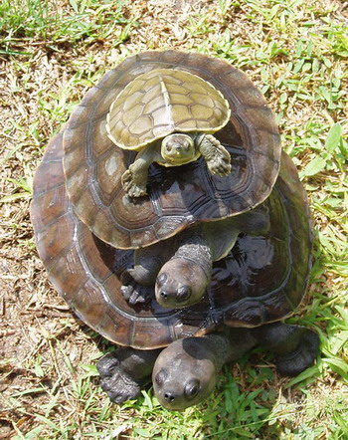
Systems of systems
It’s turtles all the way down!
Vehicles are/will be
large collections of (IoT) devices flying in formation
themselves IoT devices
mobile bits of cloud infrastructure
providers of physical transportation services as part larger cyber-physical systems
Exploit self-similarity
At any level, a system’s security properties are dependent on, but not solely determined by, the security properties of its constituents.
Can we devise rules for composing security properties?
How can certification of constituents be leveraged in assessing the security properties of a system?
Bottom up or top-down?

Slide 10
Elements of a way forward
Harmonisation and modularity of certification schemes:
Avoid waste of effort in certifying against a second scheme
Agile certification: reduce timescales and costs through automation
Formalisation of protection profiles and product claims to allow automated reasoning
Composability: learn how to stack turtles
Continuous assurance: monitoring behaviours and risk levels ‘in the field’
User process that complements certification
Product claims justified? Right PP?
Allow for evolution of PP and standard during active lifetime of product
Impact on product instances in field
Whole lifecycle approach: ‘requirement to retirement’

Slide 11
Whole lifecycle approach
Maintenance
Continuous Assurance
End of life
Design/
development
Selection/integration/deployment
In service support
Decommisioning
Security by design
DevSecOps
Gather evidence supporting certification
User must be able to make informed decisions
Including updates.
Deal with (temporary) downgrading of security status of devices in field
Certification and Release

Slide 12
Questions for discussion later:
Thoughts on the above?
What is the alternative to product security certification?

Slide 13
Introducing the Compliance Class
Customer / end-user
Manufacturer / supplier
This Photo by Unknown Author is licensed under CC BY
Compliance Class
CC3
CC2
CC1
CC0 Basic Security
CC4 High Security
This Photo by Unknown Author is licensed under CC BY-SA-NC
Req’ts
Usage
Procurement guide
Controls
Assurance Framework
Usage constraints

Slide 14
The Compliance Class concept is overloaded
Amount of security required
Compliance Class
CC3
CC2
CC1
CC0 Basic
CC4 High
Rigour of compliance assurance required
For high AC, risk assessment dominates CF
Rigour of risk assessment required
Default to full risk assessment if difficult to determine AC

Slide 15
Security certification practices and trends
Consumer IoT codes of practice
ETSI and NIST standards and certification schemes
Common Criteria
EU Cybersecurity Act and ECCF

