Slide 1


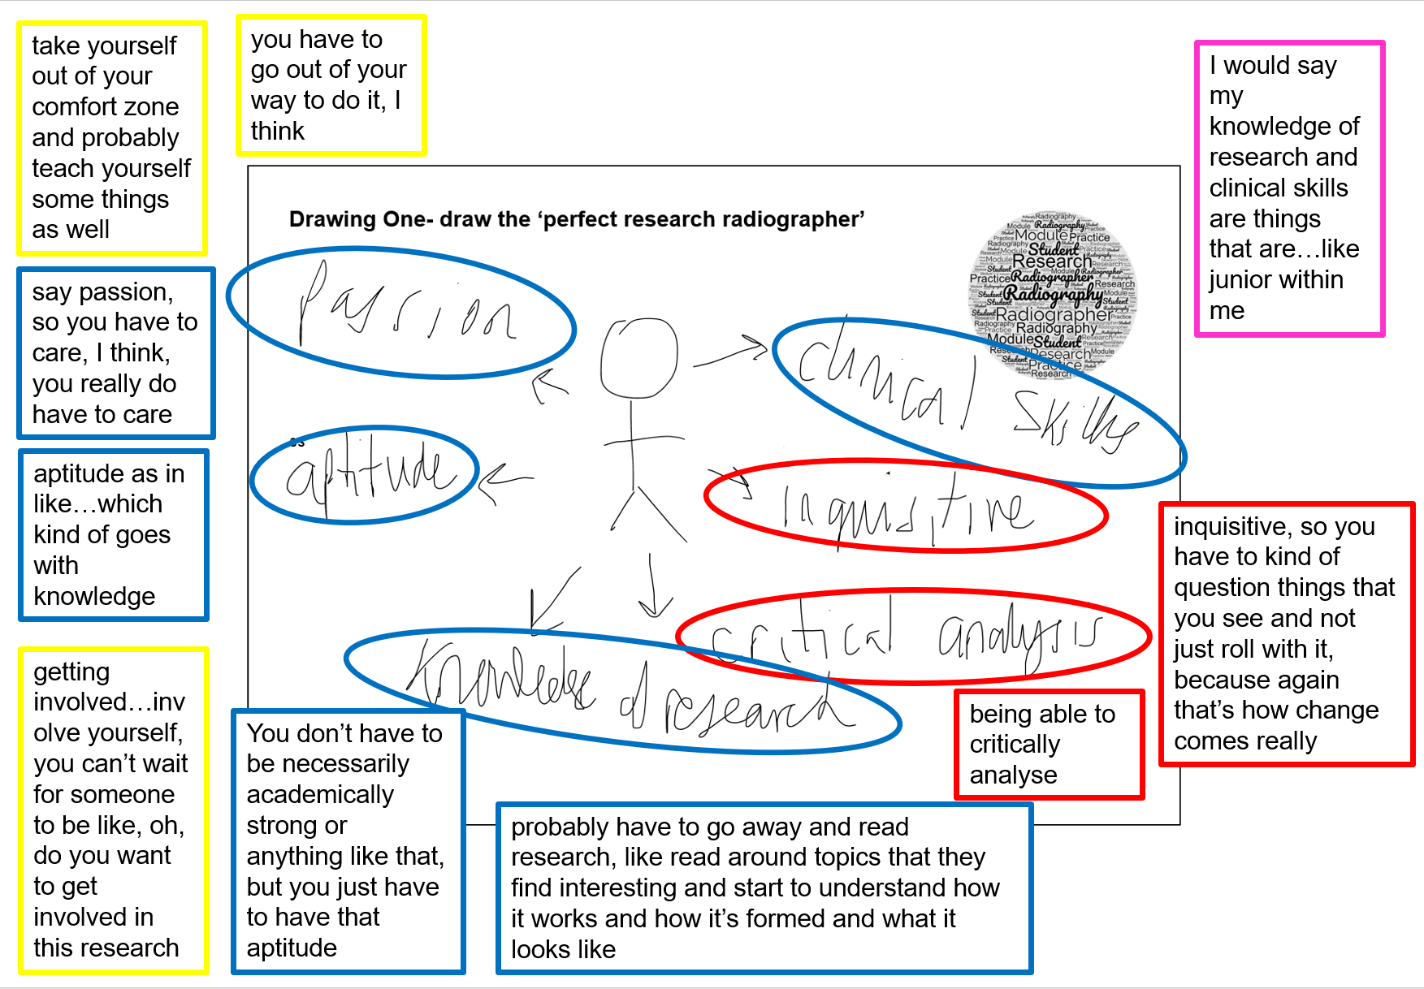
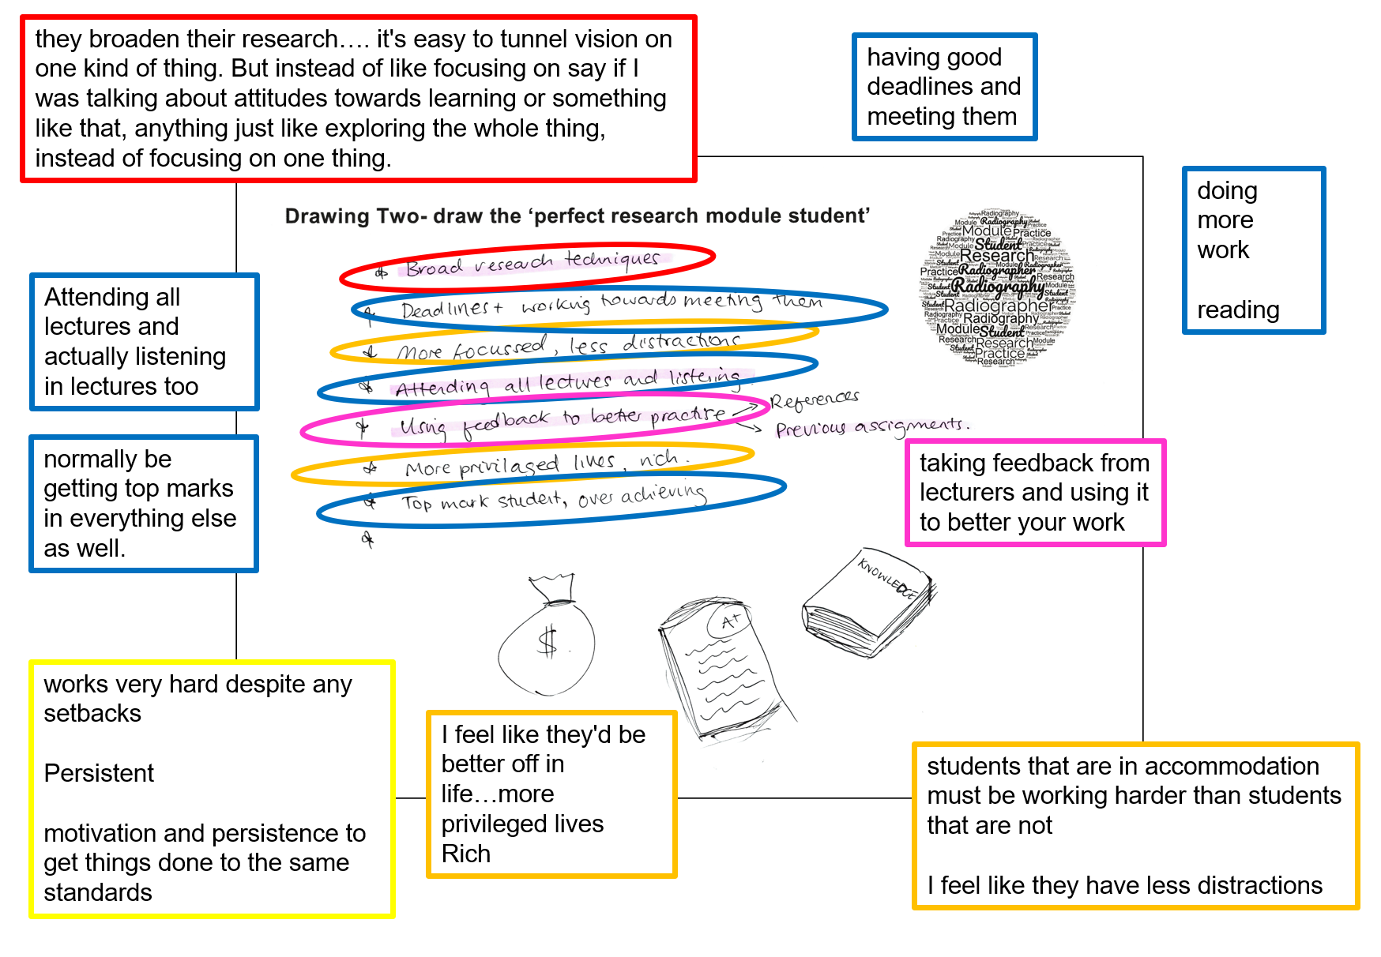
Breaking down barriers: Understanding positive deviance in the context of undergraduate radiography research culture
Dr. K Louise McKnight¹, Dr. R Higgins², James Michael¹, Lianne Potter¹ , Jeremy Lima¹, Prof Judith Dyson¹
¹Birmingham City University, ² University of Salford
Introduction
The term ‘positive deviance’ is used to describe the behaviour of an individual or team who are successful in any situation. For example, Baxter et al. (2016. p190) define positive deviants as people who “demonstrate exceptional performance, despite facing the same constraints as others.” Lawton et al. (2014) discuss improvements in healthcare which come about from the actions of people who are identified as positive deviants in clinical settings. They suggest that the first step is to identify these positive deviants and then understand how they succeed, and how their practice has led to better clinical practice and patient outcomes.
We took a step back into the higher education setting to ask student diagnostic radiographers how they understand the phenomenon by which some students and qualified radiographers appear to do well, in the context of above average performance in research tasks such as
assessments and continuing to have an active role in research in clinical and academic practice in the face of many perceived barriers. Our aim was not to uncover barriers to success, but rather to understand what it might be about individuals, from their own and others’ perspectives, which lead to success, sometimes in the face of difficulties. The research question was:
‘How do radiography students understand successful attributes in relation to research teaching and learning?’
Finding out what success looks like from a range of students will inform future research pedagogy and curriculum development in radiography and other Allied Health Professions (AHPs) as positive deviant behaviour modelling can be shared
Method
Six third year diagnostic radiography students from BCU (4) and UoS (2) responded to invitations to take part in online interviews and to draw their ideas during the recorded interview.
We asked participants to draw and talk through three main questions:
1. On the piece of paper, please could you draw the ‘perfect research radiographer’ with their skills and attributes around them.
2. What do you think ‘perfect research radiographers’ do to get over the things that hold them back from being successful?
3. On the second piece of paper please could you draw the ‘perfect research student’ radiographer’ with their skills and attributes around them.
Visual knowledge for a radiographer is formed by medical images that are interpreted to give a written report of what was seen. In this research, the visual knowledge was the participants’ drawings and while some translation into written knowledge was done in the analysis, the participants’ drawings are part of the presentation of results (see right).
.
Co-Constructed Depictions
Co-Constructed Depiction (McKnight 2020) was used to analyse and display the data. A sample of the Co-Constructed Depictions from the research are shown below.
Image 1: Co-Constructed Depiction participant S2, drawing 1.
Image 2 Co-Constructed Depiction participant B3, drawing 2.
Results
Each participant produced two drawings during the interviews. The interview transcriptions were read by the team and the ‘puncta’ (Barthes 1981) picked out. From these, six themes were identified:
1. Habitus- skills and abilities embedded in a person
Here we identified skills and abilities such as academic and communication skills, being focussed, and being motivated to do well in research. For students this included being ‘present’ in lectures and actively listening.
Critical outlook/approach to practice and research
Students talked about having an interest in acquiring knowledge, being curious and keeping up to date. They suggested that questioning things and being a critical practitioner were important.
Pushing boundaries- vision
Successful research radiographers were said to be hard working despite setbacks, having drive and motivation to stand out, and to go against the grain and push against opposition.
Patient focus- knowledge to care
Some of the drive to do well in research was linked to care of patients and radiation safety, perhaps unsurprisingly for future clinical practitioners. Students mentioned the application of knowledge in the context of evidence based practice, and knowledge mobilisation.
External factors
For some students there were factors which they felt a successful student may have, but which was denied to themselves. One mentioned that some successful students might have more privilege, for example having more disposable income, and having quieter places to learn outside the family home. Other external factors included resources and workload which may not help radiographers to succeed with research as these were seen as competing factors.
Teaching and Learning
Many of the responses and the themes above were related to teaching and learning as well as future research skills and abilities. Students identified the need to have a core knowledge of research and that they needed to learn with their peers. They did not always identify in themselves the skills, abilities and vision that they felt were needed for success.
Conclusion
Understanding the drivers possessed by positive deviants and how they are perceived by others with regard to their activity on the research spectrum will be incorporated into future teaching, particularly in enthusing undergraduate students to become more research
active and understanding how they can themselves be successful as researcher practitioners in the future.
Not all barriers are external, so we can help students overcome internal barriers.
For full reference list and authors’ contact details, please see files in the Stack. Funded by BCU HELS Pilot Project Funding 2022
Notes:
Copyright Colin Purrington (http://colinpurrington.com/tips/academic/posterdesign).

