Slide 1




DISCLOSURE
Nothing to disclose

Slide 2

Developing and using a new qualitative methodology - Co-Constructed Depiction
Dr. K. Louise McKnight

Slide 3
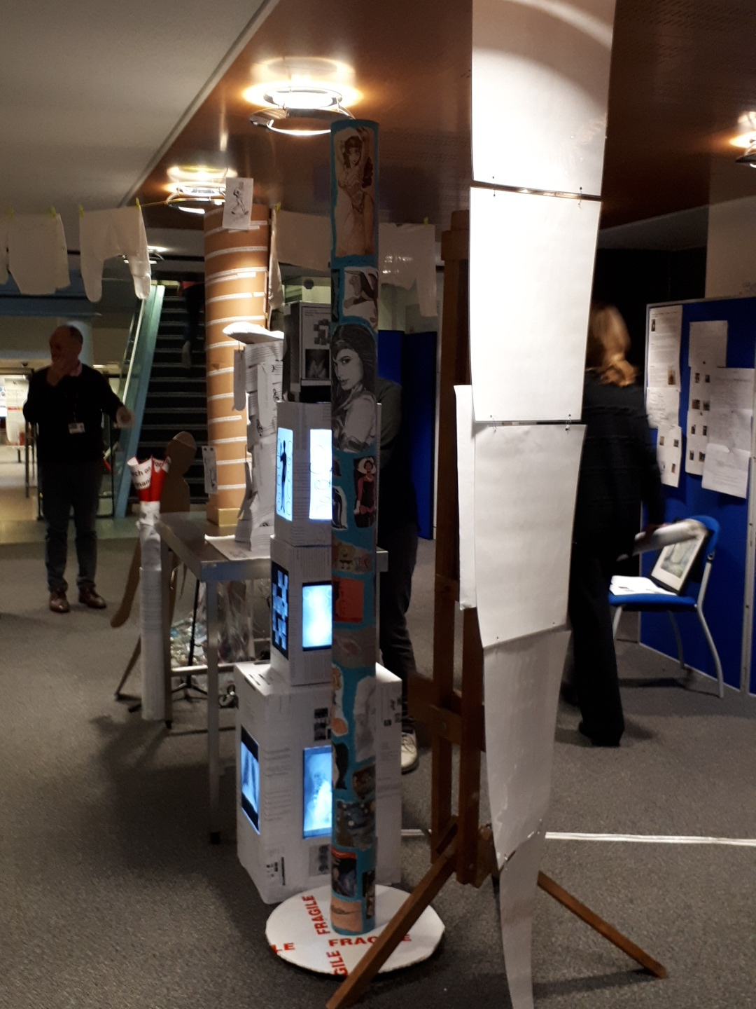
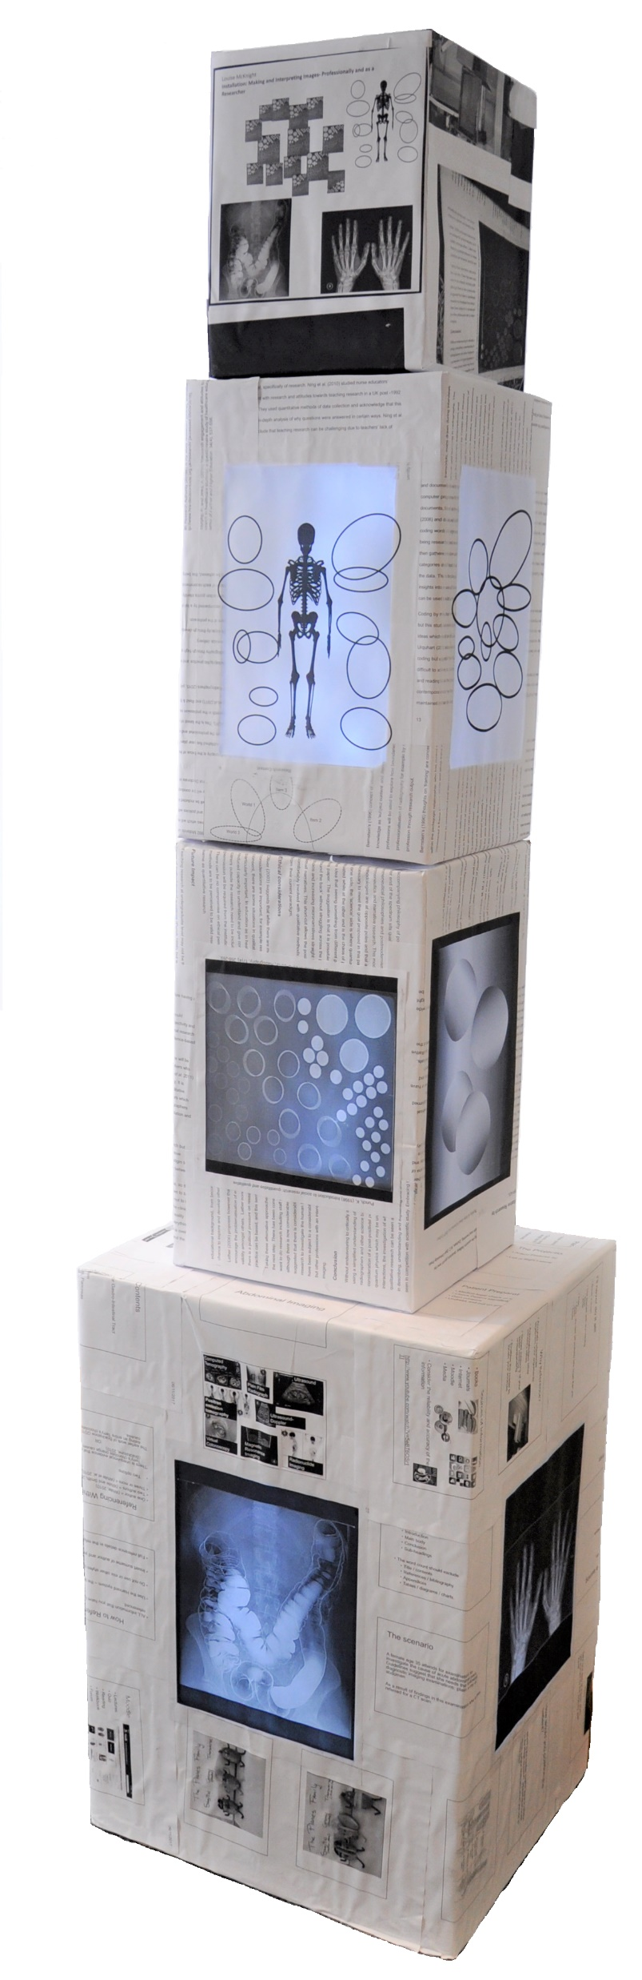

Slide 4

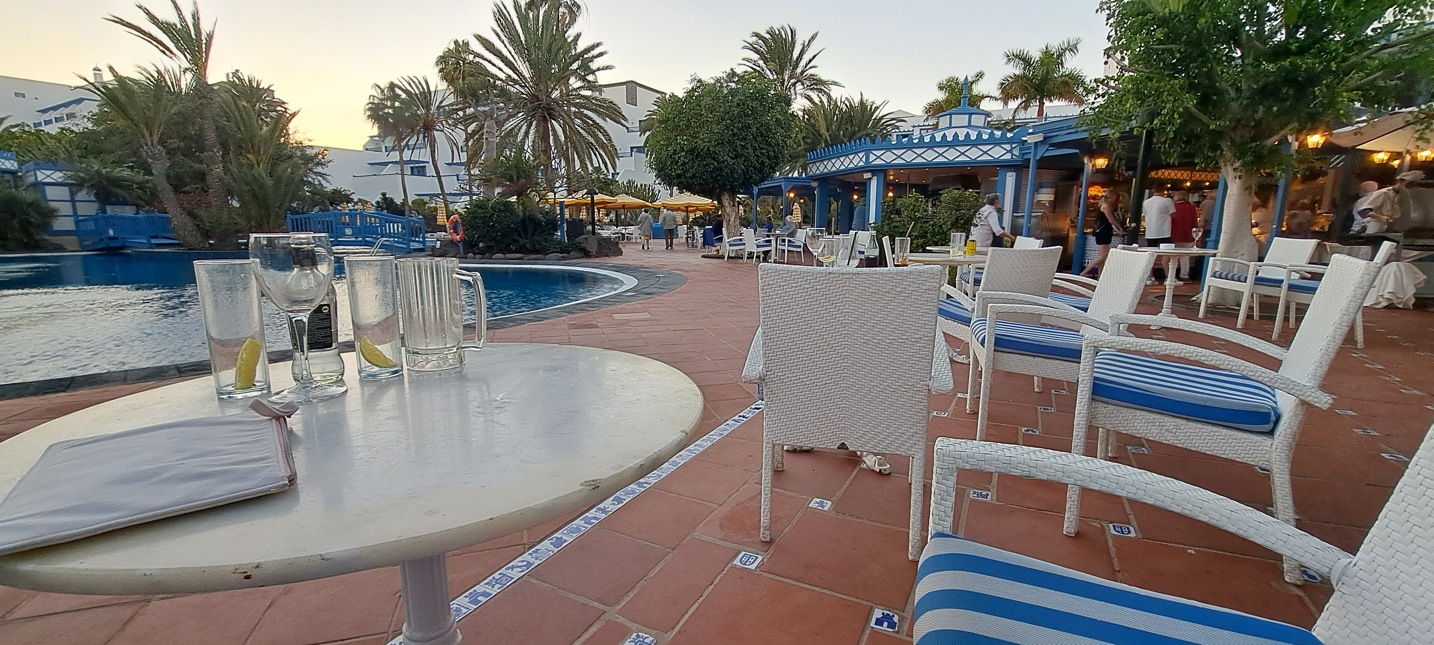

Slide 5
Development of
Co-Constructed Depiction
McKnight, K. L (2021) Research pedagogy in a UK radiography education setting. Radiography. https://doi.org/10.1016/j.radi.2021.08.002

Slide 6
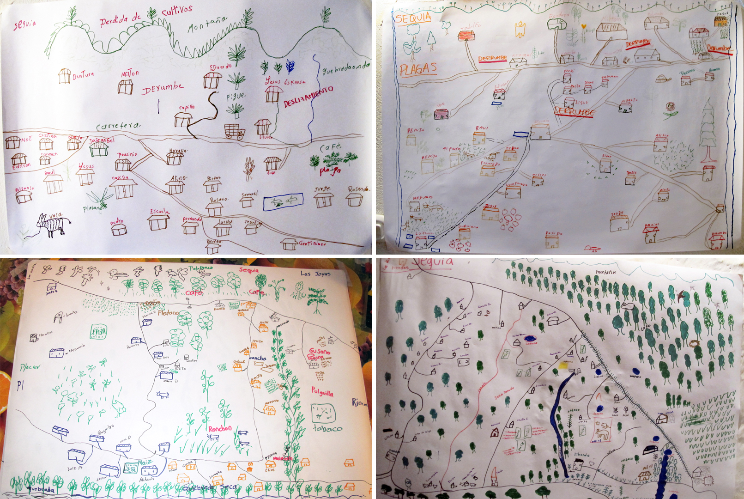
"Maps drawn by different groups during the workshop" by Bioversity International is licensed under CC BY 2.0. To view a copy of this license, visit https://creativecommons.org/licenses/by/2.0/?ref=openverse.

Slide 7
Previous experience
HCPC
QAA
NHS staffing issues
SOR Research
Document
Society and College of Radiographers
Health
Education
England
University
Policies
Adapted from Clarke, A. (2005) Situational Analysis: Grounded Theory After the Postmodern Turn. SAGE Publications.

Slide 8
Item 3
World 1
Item 2
World 3
Main Arena under Investigation
World 2
Item 1
Item 4
Adapted from
Doing Situational Maps and Analysis
By:
Adele E. Clarke
In:Situational Analysis
Chapter DOI:https://dx.doi.org/10.4135/9781412985833.n3

Slide 10
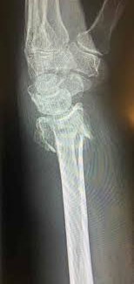
Data Analysis
Barthes (1981)- studium and puncta
Adapted thematic analysis - Braun and Clarke (2022)
Co-Constructed Depiction McKnight (2020)
Colles' fraktue, Av Per-Henrik Randsborg., Lisens: CC BY SA 3.0 https://sml.snl.no/Colles%27_fraktur (accessed 2.6.23)

Slide 12
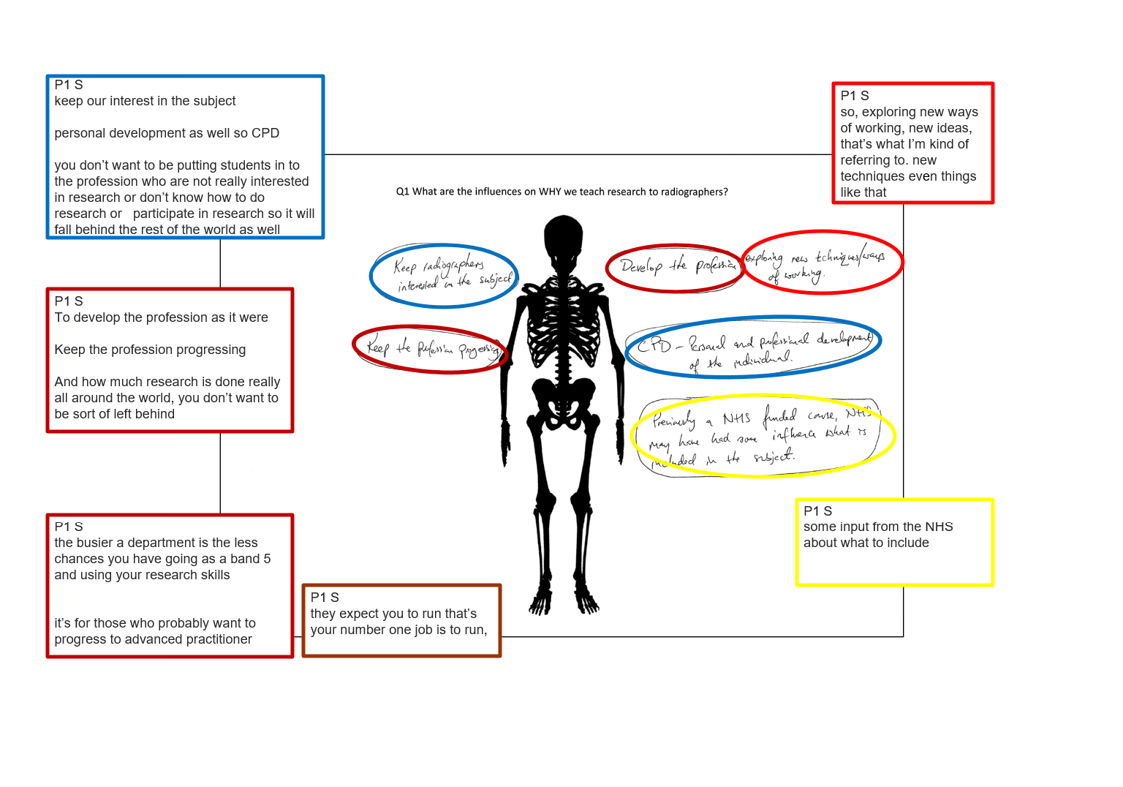

Slide 13
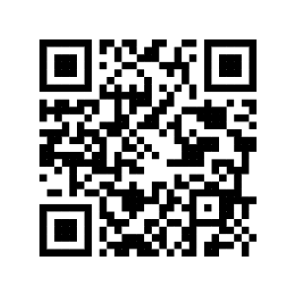
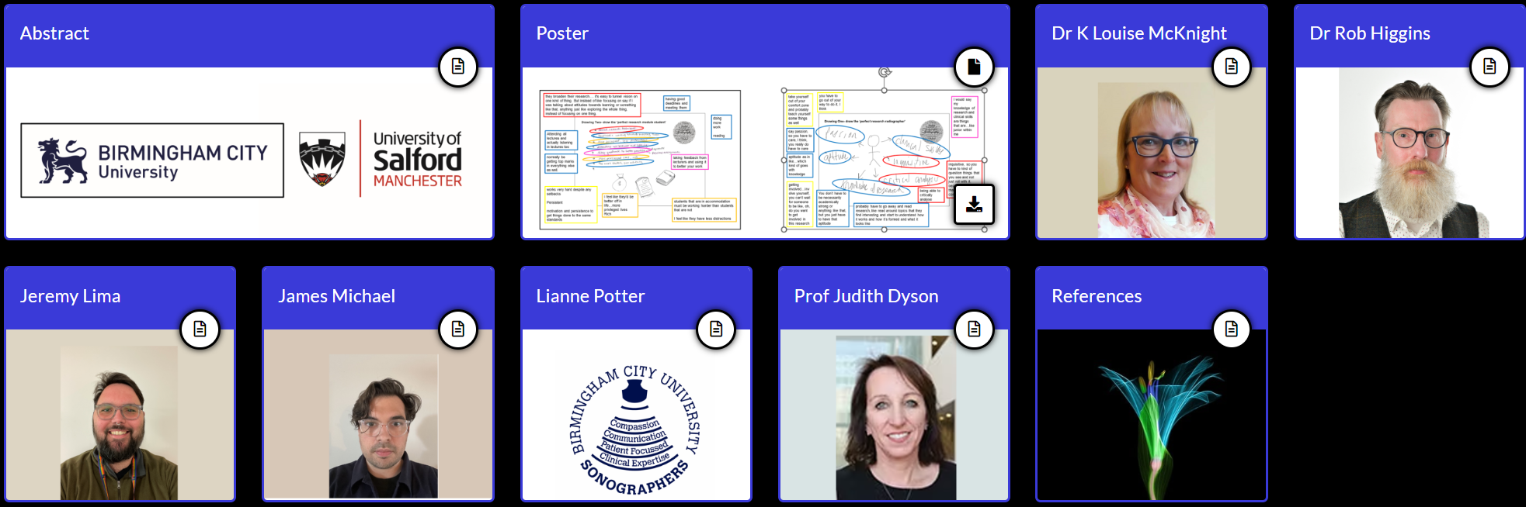
Understanding the impacts of positive deviance to develop the student research culture in undergraduate radiography

Slide 14
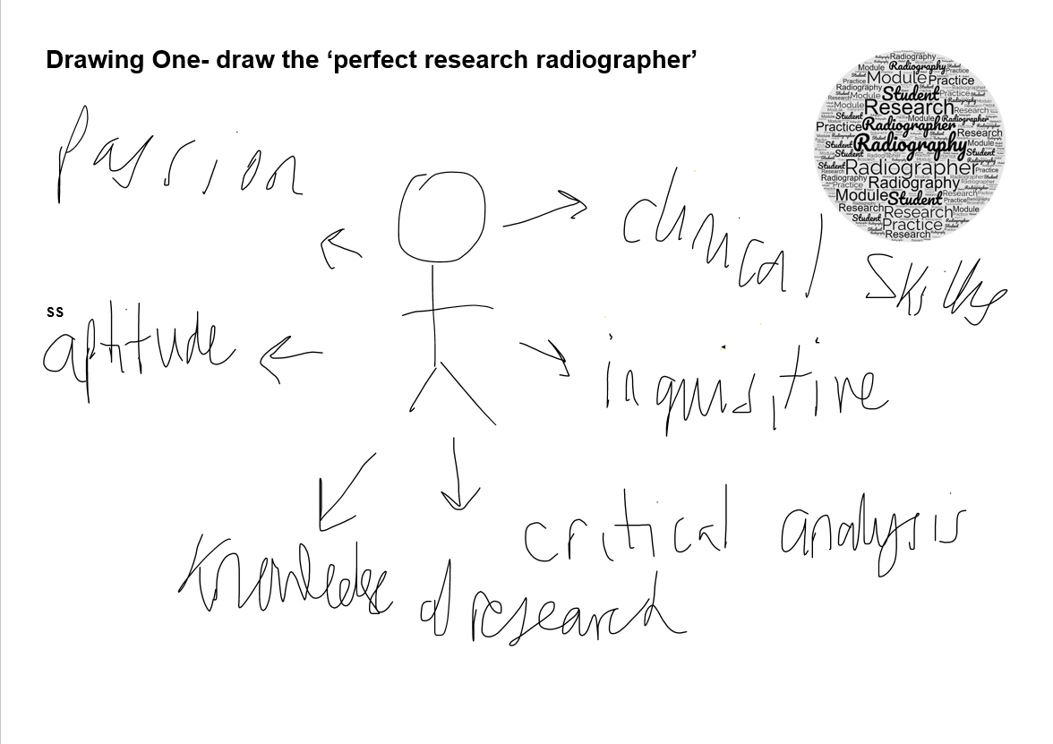
take yourself out of your comfort zone and probably teach yourself some things as well
you have to go out of your way to do it, I think
I would say my knowledge of research and clinical skills are things that are…like junior within me
say passion, so you have to care, I think, you really do have to care
aptitude as in like…which kind of goes with knowledge
inquisitive, so you have to kind of question things that you see and not just roll with it, because again that’s how change comes really
getting involved…involve yourself, you can’t wait for someone to be like, oh, do you want to get involved in this research
You don’t have to be necessarily academically strong or anything like that, but you just have to have that aptitude
being able to critically analyse
probably have to go away and read research, like read around topics that they find interesting and start to understand how it works and how it’s formed and what it looks like

Slide 15
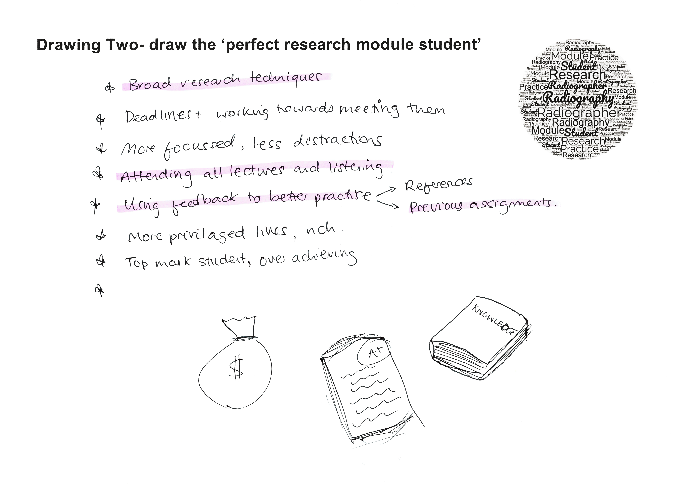
they broaden their research…. it's easy to tunnel vision on one kind of thing. But instead of like focusing on say if I was talking about attitudes towards learning or something like that, anything just like exploring the whole thing, instead of focusing on one thing.
having good deadlines and meeting them
doing more work
reading
Attending all lectures and actually listening in lectures too
normally be getting top marks in everything else as well.
taking feedback from lecturers and using it to better your work
works very hard despite any setbacks
Persistent
motivation and persistence to get things done to the same standards
I feel like they'd be better off in life…more privileged lives
Rich
students that are in accommodation must be working harder than students that are not
I feel like they have less distractions

Slide 16
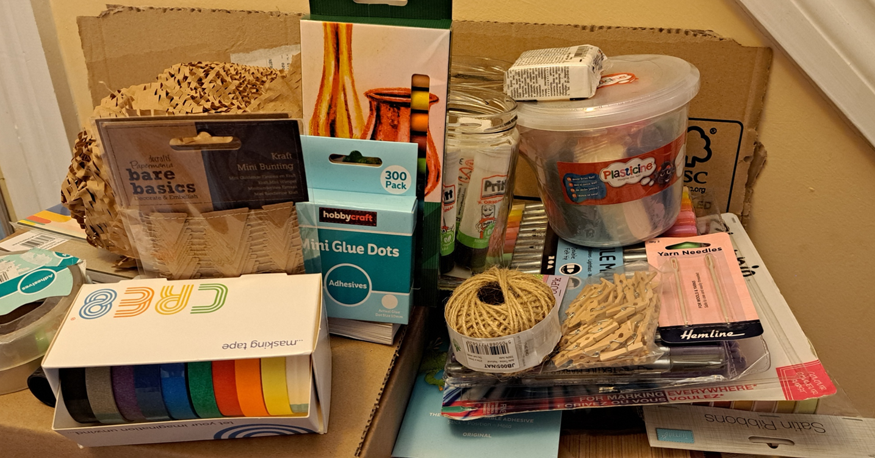
The next step- breaking into 3 dimensions

Slide 17
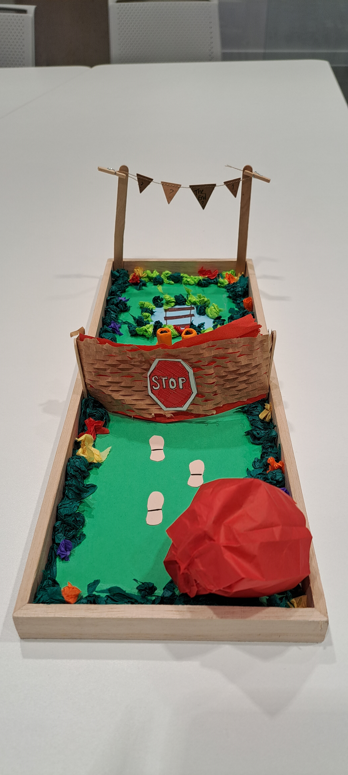
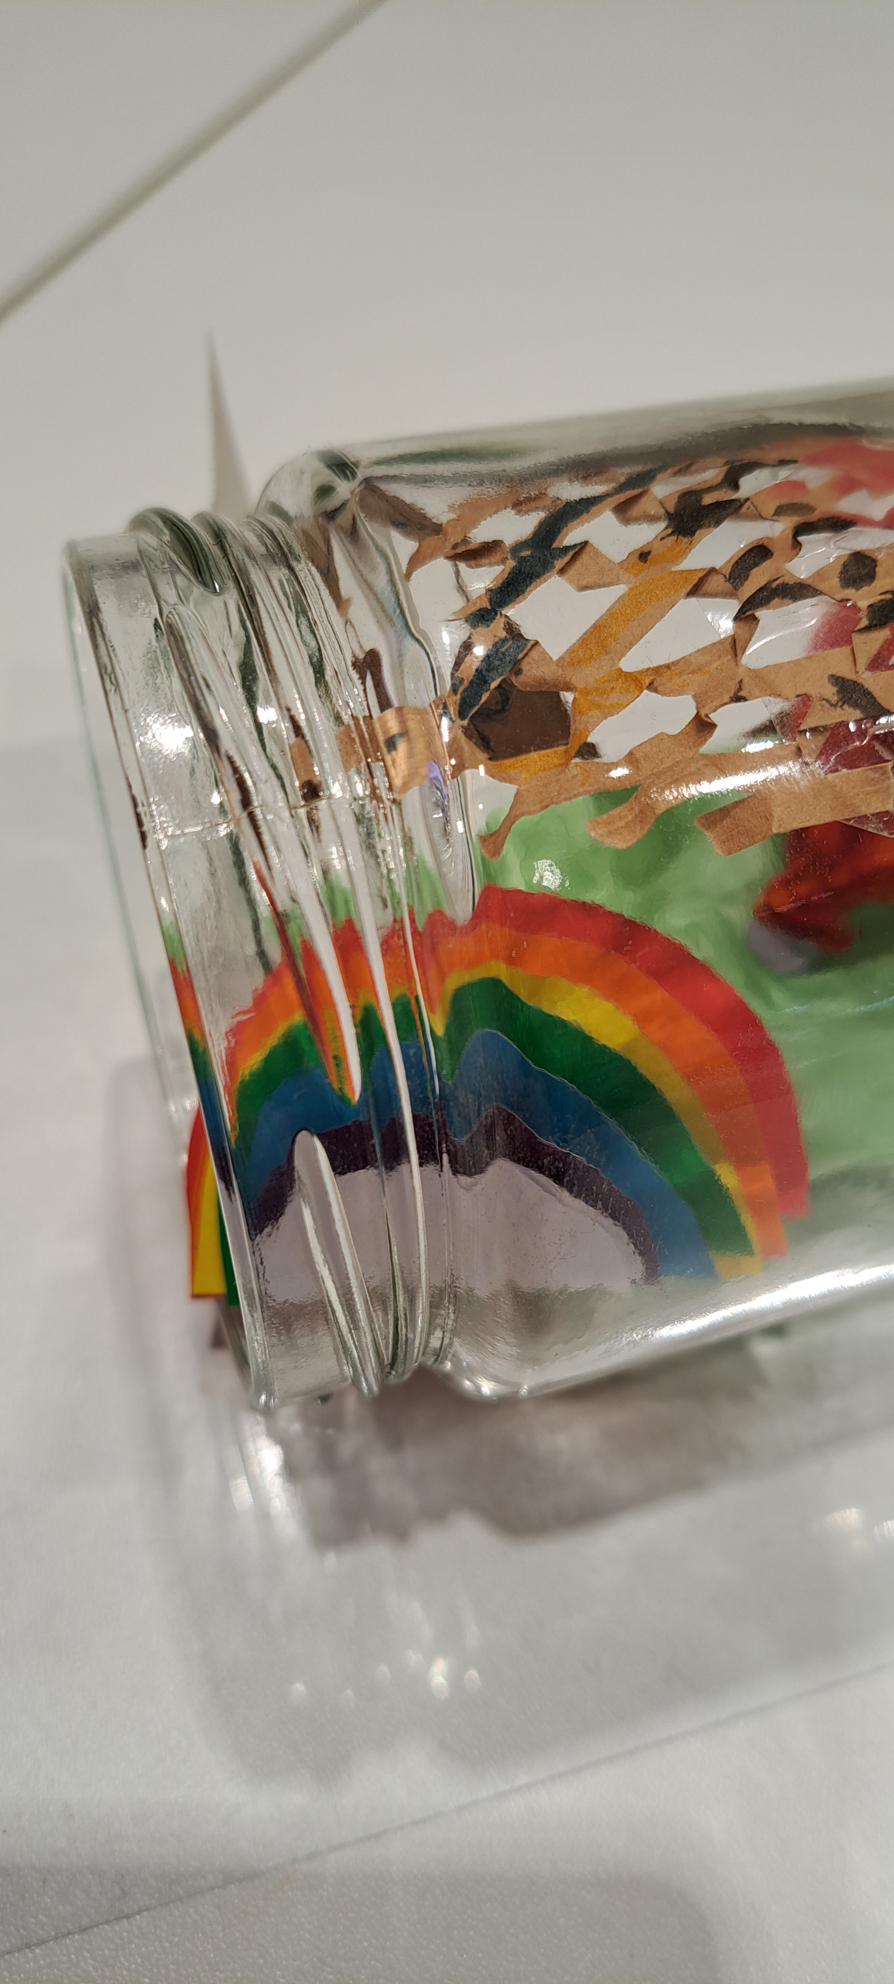
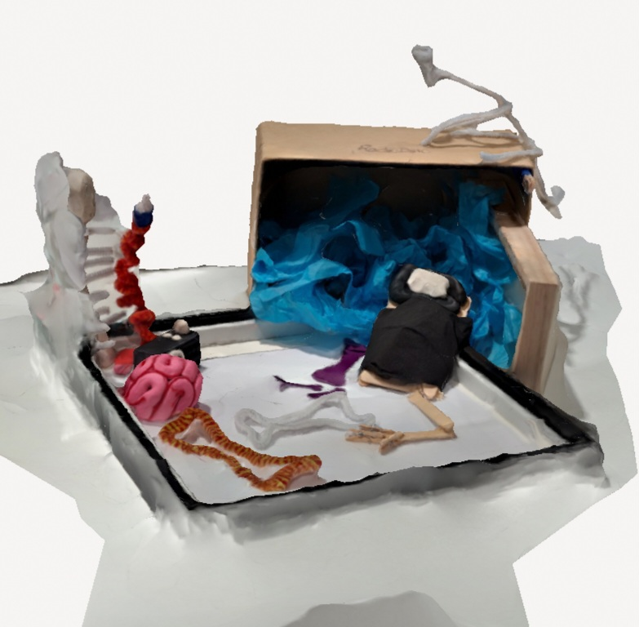

Developing ‘Co-Constructed Depiction’ methodology using a STEAM-collaborative approach

Slide 18
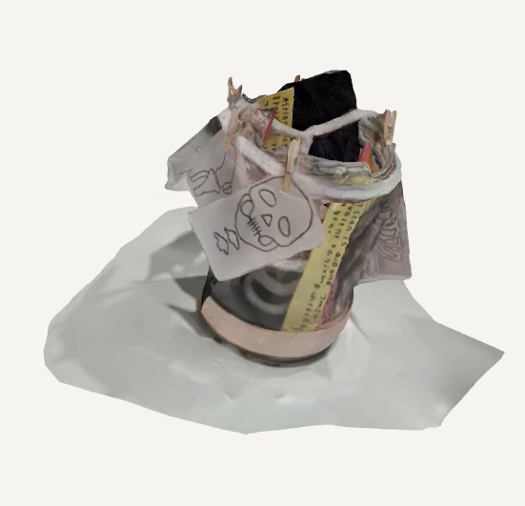

Slide 19
References
Barthes, R. (1981) Camera lucida: Reflections on photography. Macmillan.
Braun, V. and Clarke, V. (2022) Thematic analysis : a practical guide. Los Angeles: SAGE.
Clarke, A. (2005) Situational Analysis: Grounded Theory After the Postmodern Turn. SAGE Publications.
McKnight, K. L. (2020) ‘So, What Are We Looking at Here?’ - Research, its Position and Pedagogy in the UK Radiography Profession. Professional Doctorate in Education Thesis. Birmingham City University. Available at: http://www.open-access.bcu.ac.uk/id/eprint/10986
McKnight, K. L. (2022) Research pedagogy in a UK radiography education setting. Radiography (Lond), 28(1), pp. 80-87. doi:10.1016/j.radi.2021.08.002
IMAGES
"Maps drawn by different groups during the workshop" by Bioversity International is licensed under CC BY 2.0. To view a copy of this license, visit https://creativecommons.org/licenses/by/2.0/?ref=openverse. https://www.flickr.com/photos/50383637@N07/8866146949 (accessed 2.6.23)
Colles' fraktue, Av Per-Henrik Randsborg., Lisens: CC BY SA 3.0 https://sml.snl.no/Colles%27_fraktur (accessed 2.6.23)
With thanks to Learning Toolbox for the images of our e-poster
All other images are © Dr K Louise McKnight

Slide 20

Any questions?
@KLouiseMcKnight

