Slide 1

Part-time spaces:
rethinking ‘belonging’ in HE
Enduring Inequalities and New Agendas for Widening Participation in Higher Education: Student Access, Mobilities and ‘Success’
27 July 2016, University of Leeds
Dr Kate Carruthers Thomas
Research Fellow
Birmingham City University

Slide 2
thinking ‘spatially’
spatial/power relationships of higher education
how spaces are appropriated and inhabited and by whom
  space: the product of social relations shaped by power … a confluence and product of histories, relationships … the sphere in which distinct trajectories coexist’ (Massey 2005, p.9),
  activity space: the spatial network of links and activities, of spatial connections and of locations, within which a particular agent operates … within each activity space is a geography of power. (ibid. p55).

Slide 3
part-time spaces?

Slide 4
retention and belonging
At the heart of successful retention and success is a strong sense of belonging in HE for all students. This is most effectively nurtured through mainstream activities that all students participate in … our definition of ‘belonging’ is closely aligned with the concept of student engagement, encompassing both academic and social …
-------
… choosing to continue to live in the family home rather than university accommodation or with student peers … combining part- or full-time study with employment … postponing entering HE and thus studying as mature students. All of these factors may make it difficult for students to fully participate, integrate and feel like they belong in HE, which might have a detrimental impact on their retention and success.
Thomas (2012) Education at a time of change; What Works

Slide 5
problematising ‘belonging’
Belonging … is often used in a way that implies a common understanding of what belonging is and why belonging is important. Needless to say, no such common understanding exists.
Practices of belonging within a place not only mark the claims of particular groups to particular territories, but in doing so, inevitably identify ‘the other’, excluding on the basis of difference, defined and implemented through relationships of power.
(Mee and Wright 2009, p772)

Slide 6
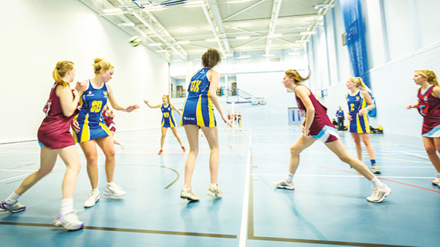
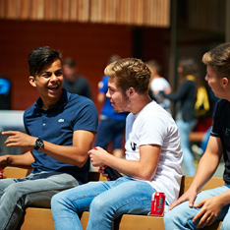
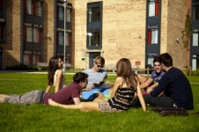
practices of belonging
academic: disciplinary/cohort
social: sports/enrichment/voluntary/leisure
presence on campus/outside contact hours
… a geography of places – the bars and ‘student-friendly’ pubs where students can meet new people, the hall of residence, the canteens … the student community is stitched together out of these places; it relies on this geography. (Crang 1998, p.5)

Slide 7
who belongs?
mature part-time undergraduates occupy a peripheral – and increasingly precarious – position in English HE
dominant ideas of ‘belonging in HE’ are problematic in the context of a diverse undergraduate population
… mature, working-class and minority ethnic students often choose to apply to post-1992 universities in order to increase their chances of belonging in an academic culture … to reduce their feeling of ‘otherness. (Read et al. 2003).

Slide 8
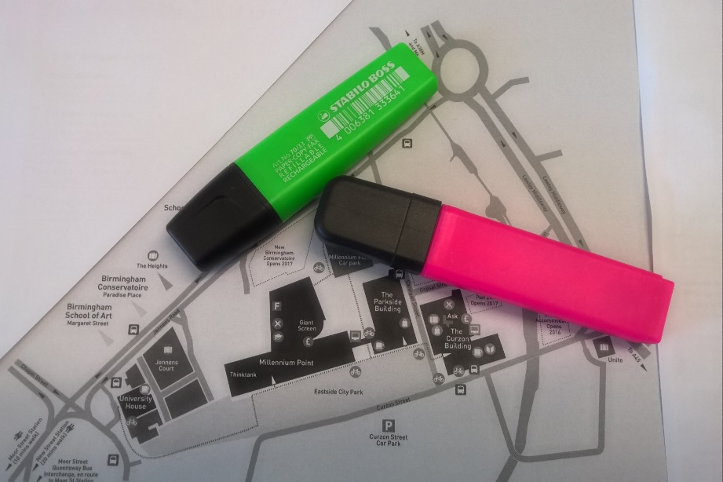
mapping belonging
student participants
campus maps/coloured pens
hot/cold spots, different colours
trigger for discussion
on the map? off the map?
Participant-generated visual materials are particularly helpful in exploring the taken-for-granted things in their research participants’ lives … involves the participants reflecting on their activities in a way that is not usually done; it gives them distance from what they are usually immersed in and allows them to articulate thoughts and feelings that usually remain implicit.
Rose 2014, p.27

Slide 9
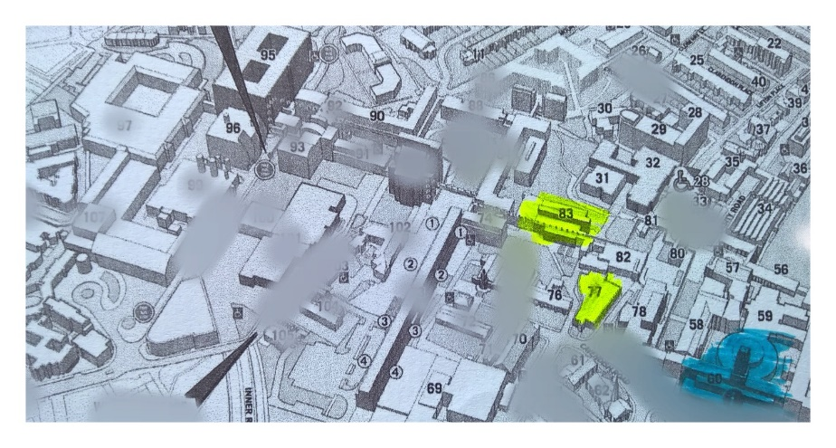
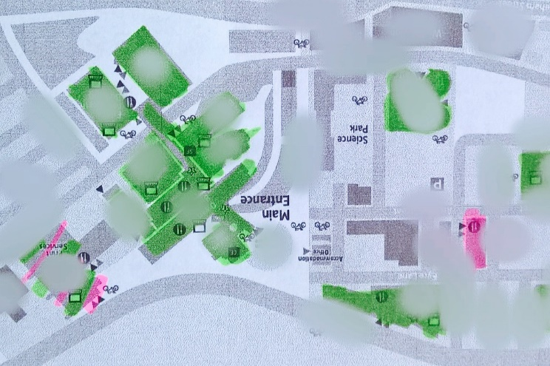
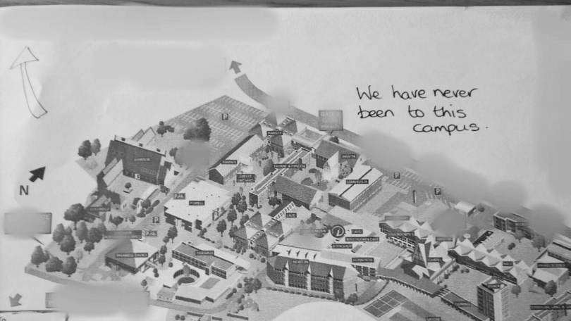
mapping belonging

Slide 10
mapping engagement …
HE
mature part-time engagement in HE
heterogeneous individuals
simultaneous, multiple commitments
complexity
work
home
community
institution-centric retention
  linear
  bounded
  homogenous
%
#

Slide 11
TEF
assessment metrics
student satisfaction
retention
graduate employment / earnings
qualitative institutional submission
expert judgements
=
tuition fee increases

Slide 12
dimensions of belonging
belonging as uniform and finite (common understandings) and belonging as a relational, contested, dimensional process
‘belonging in HE’ – common space(s) experienced in multiple ways
negotiated engagement with space:
    Facebook pages/groups
    shared lunches
    group outings
    professional identity
    roles of responsibility
    branded clothing

Slide 13
shared ownership
at the interface of the individual and the institution
coinciding interests, common effort, through and beyond the university
localised – tutors, teachers, support staff
bridging rhetoric and experience with compensatory behaviours
hard to measure but critical work

Slide 14
thinking spatially?
relationships of power
  dominant and marginal practices of belonging
negotiating space(s) to belong
dimensions of belonging, spaces between: cohort, professional identity
implications for institutional practice? transferability?

Slide 15
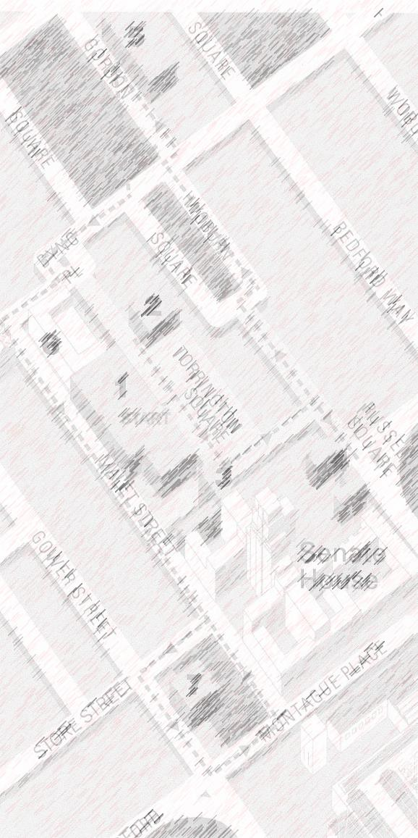
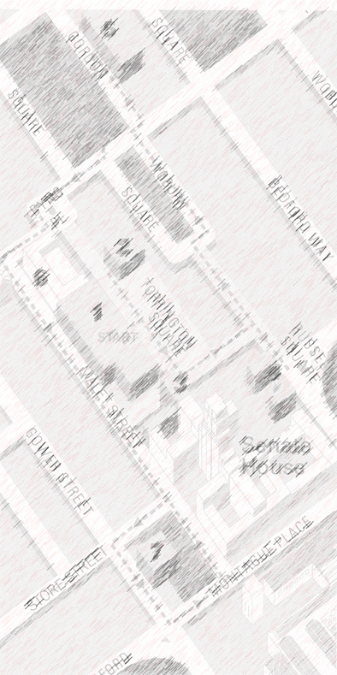

QUESTIONS?
THANK YOU
kate.thomas@bcu.ac.uk

