Slide 1




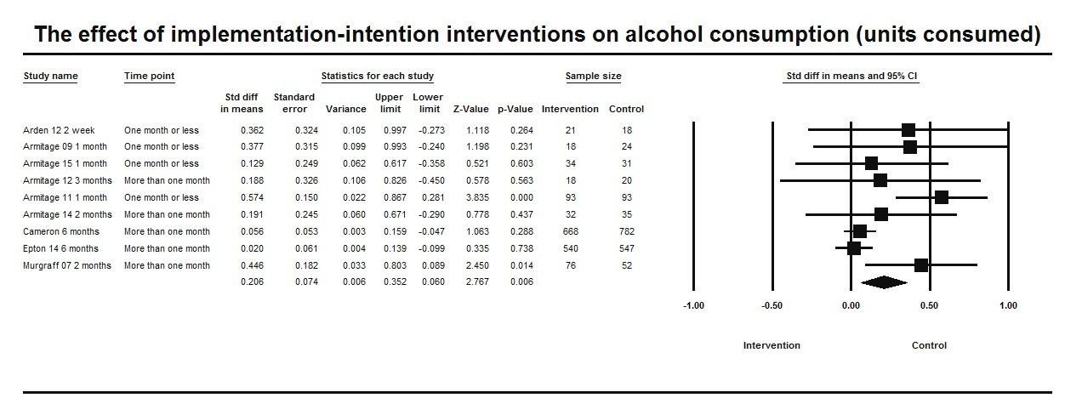

Do implementation intentions reduce alcohol consumption? A meta-analysis
Richard Cooke¹ Helen Lowe²
¹ Aston University ² Birmingham City University
Background: Asking individuals to form implementation intentions (II; i.e., if-then plans) has been shown to reduce subsequent alcohol consumption. The objective of this study was to quantify the effect-size difference in alcohol consumption between individuals forming II versus not forming II.
Methods: Systematic literature searches were conducted using the following databases: Cochrane Database of Systematic Reviews; EThOS; PsychArticles; PubMed; Web of Science.
Findings: Random-effects meta-analysis was performed (N = 3102; K = 9) using effect-size differences (d) in unit alcohol consumption between participants who formed II versus did not form II
A small, significant, positive effect-size difference in unit alcohol consumption was found (d+ = 0.21 [0.06; 0.36]; χ²(8) = 17.71, p = 0.02).
Findings: Length of follow-up was examined as a moderator.
A small, significant, positive effect-size difference in alcohol consumption was found when follow-up was within one month (d+ = 0.43 [0.21; 0.66]; χ²(3) = 2.43, p = 0.49).
A non-significant effect-size difference was found when follow-up was beyond one month (d+ = 0.07 [-0.02; 0.17]; χ²(4) = 5.36, p = 0.25)
Discussion: Meta-analysis confirms the utility of implementation intentions as an intervention to reduce alcohol consumption: Individuals who formed implementation intentions reported lower alcohol consumption at follow-up than individuals who did not form implementation intentions. These effects were stronger for shorter follow-up time points.
Contact details: Email r.cooke@aston.ac.uk Twitter @DrRichardCooke

