Slide 1
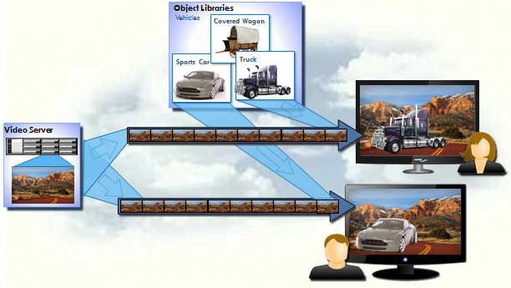
OBJECT-MEDIA: FROM PERSONALISATION TO A SEAMLESS TV/VR CONVERGENCE
This presentation proposes in-video personalisation using object-based media for the insertion of externally sourced video placements into broadcast content (real-time or on-demand). Placement content is selected in accordance with viewer profiles, and may be produced independently of the source video.
Using this this technology user-object interaction is also possible. Use cases, include personalised product placement, training, education and accessibility for hearing and visually impaired viewers. The technology specifically fits existing distribution platforms (cable, satellite, DTTV, IPTV/OTT) with minimal infrastructure upgrade.
Birmingham City University, MOG Technologies and Big Bad Wolf are all involved in the development of the production, imaging and delivery technologies to realise this next generation of a seamless TV and VR convergence.
Jeremy Foss, Birmingham City University, UK
jeremy.foss@bcu.ac.uk
Alexandre Ulisses, MOG Technologies, Portugal
alexandre.ulisses@mog-technologies.com
Nicolas Monnoyer, Big Bad Wolf, Belgium
n.monnoyer@bigbadwolf.be
Go To Introduction and overview
This presentation – given at the International Broadcasting Conference Futurezone, IBC 2016, Amsterdam, September 2016

Slide 2
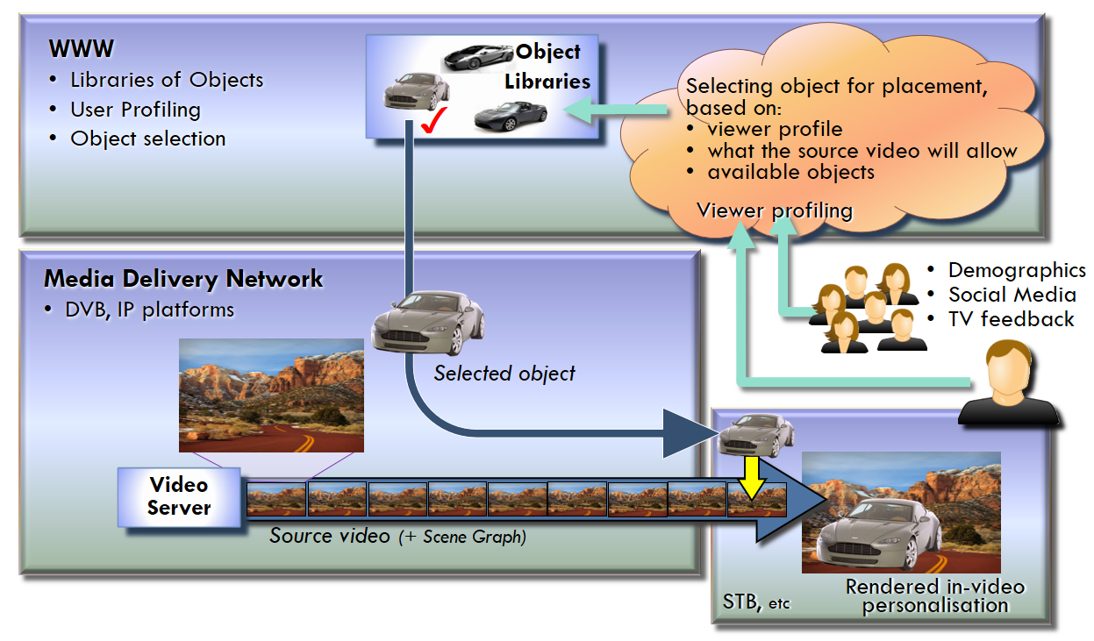
OBJECT-MEDIA: FROM PERSONALISATION TO A SEAMLESS TV/VR convergence
In-Video Personalised Interactive TV
Personalised Interactive TV
This concept has been presented in which video objects are selected in accordance with a viewer’s profile (click for details) and delivered to the user for insertion into a broadcast video.
The proposal also allows that placements are allowed to be manipulated by users for additional interaction, including with collaborative groups across the network.
Example applications are:
advertising, specifically for personalised product placement
accessibility, where the programme may be augmented with audio objects to assist visually impaired viewers, or video objects to assist hearing impaired viewers
entertainment, including collaborative team interaction for personalized games in the broadcast domain
education, including personalized documentaries.
Video Objects - selection for the viewer
Personalised placements are achieved with user profiling (see more here). Profiles are accrued on the basis of a number of available parameters including demographics, geography, TV consumption behavior, online behavior including social network activities if made available.
Continued on next page click here
The placement insertion is the product of matching the source programme, the user profile and the placement object.
Go to …
Metadata, Scene Graphing
Production Challenges, Profiling
Viewer Interaction
TV - VR Seamless Services
Delivery Platform
Personalisation of Networked Video (J D Foss, B Malheiro, J C Burguillo-Rial); EuroITV, Berlin, Germany, July 2012

Slide 3
OBJECT-MEDIA: FROM PERSONALISATION TO A SEAMLESS TV/VR convergence
In-Video Personalised Interactive TV
Metadata and Scene Graphing
Descriptive metadata is important to enable this. Source video content needs descriptions for placement opportunities; the placements themselves need metadata to enable matching and selection to fit the source video. The selection would typically be made with a three-way correlation between the source and placement metadata and the viewer profile.
The source video may be delivered over one platform (DVB or IP) whilst the video objects are to be delivered by IP (over the WWW, c.f. HbbTV). Consequently a scene graph file (see more here) is delivered with the content to inform the receiving platform (STB, etc.) how the objects and source video are to be rendered for the final personalised video. Placement objects may need processing to seamlessly fit the source video. Birmingham City University are researching this area.
Distribution to the Viewer
The proposal requires minimal changes to existing architectures. The delivery platform supports all main distribution platforms.
Object based TV and VR
We then extend this proposal: VR objects may be correlated with object-based TV to lead to a TV / VR seamless convergence for advertising, entertainment, etc., and so realise a personalized collaborative broadcast VR experience.
Back to previous page
The placement insertion is the product of matching the source programme, the user profile and the placement object.
Go to …
Metadata, Scene Graphing
Production Challenges, Profiling
Viewer Interaction
TV - VR Seamless Services
Delivery Platform

Slide 4
OBJECT-MEDIA: FROM PERSONALISATION TO A SEAMLESS TV/VR convergence
Challenges in Production
Viewer Profiling
Audio or video objects are to be selected for placement into the video playout for in-video personalisation. One or more object candidates for selection are identified, and user profiles are to be used.
Profiles may be built and managed from user attributes, typically from demographics, geography, social network usage, TV consumption and interactive behavior.
An example is for user location which can be identified from IP or Wi-Fi access point identification, particularly in retail outlets, etc. The location context can be utilized for personalized promotional messages.
Interactive TV can encourage viewers to impart further information into the TV domain and to build an increasingly finer grained profile of the viewer.
Group Profiling
In many cases the programme is viewed by a number of viewers. Alternatively a group of colleagues may be watching the same programme across the network. In these cases a group profile may be realized (and especially to keep viewing family-friendly). This is an ongoing area of research at Birmingham City University.
Production issues for Broadcast VR
The vision for VR in a broadcast context is that at particular points of the programme the viewer will be able to immerse themselves deeper into various details of the subject with an interactive experience in VR, and with a number of collaborators for entertainment experiences or informative programming.
Clearly one of the main challenges is the capture and management of a number of three dimensional objects required for a full virtual environment. This won’t be possible for all objects throughout a production. An example could be that much of the production will remain as a 360º surround playout with appropriate objects available as 3D interactive objects in the scene. A production challenge here is to maintain the viewer focus on the plot and key interest features of the production.
A viewer of the initial 2D video will need a seamless experience in selection of the VR option and the transition to the VR element of the production.
Workflow processes
The production requires object management within the timeline of the video to maintain coherence in the video and correlation with any related virtual environment.
Personalisation and interactivity requires scene graphing and metadata technologies. So metadata generation and management will be a major requirement. Identification of detail in the source video may be real time or in post-production.
Placements for advertising and product placements will typically be generated and managed for advertising agencies. Metadata is to be derived for items to be promoted and advertised as available for selection, and will require hosting in web-based libraries.
Return to …
Introduction and overview
Home page

Slide 5
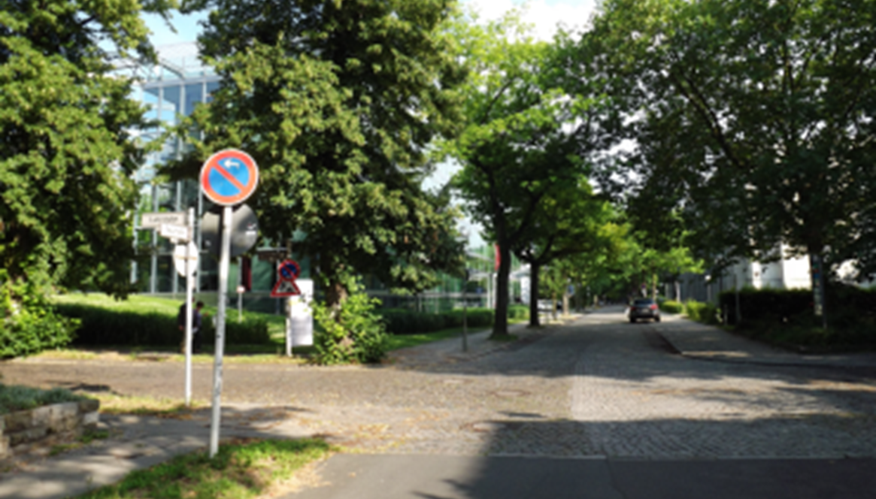
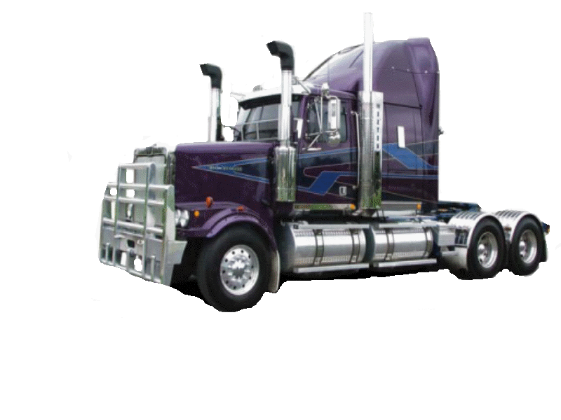
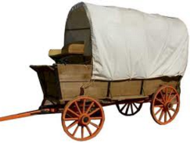
OBJECT-MEDIA: FROM PERSONALISATION TO A SEAMLESS TV/VR convergence
Selection of Object Placements for the Viewer – Metadata and Scene Graphing
Descriptive Metadata for the source content will define the time and spatial requirements for placements to be inserted into the original video. Producers will wish to maintain control and editorial integrity over acceptable placements from external sources into their production. These conditions need to be defined within the source metadata.
Similarly the placement objects also to be defined in metadata to enable the correlation with (i) the source content requirements and (ii) the viewer profiles.
MPEG-7 is suggested as a suitable metadata solution, but may need extensions to support matching external objects into source content. It is suitably rich and full featured (but complex)
A Scene Graph document is required to be sent to the viewer platform so the object can be rendered into the source video at the required time and positon, and with qualifiers for position, motion, etc. MPEG-4 Part 11 is an example of scene graphing, although a new standard should be considered to support demands of personalised and interactive broadcast media)
Broadcast Workflow Developments to Support Personalisation and Interaction. Workflows will evolve and enhancements to standards and processes are discussed here, including metadata management, scene graph processing, and coding of objects for delivery.
Source Video
❖
❖
Scene 1
Scene 1
Scene 2
Scene 2
Video Metadata File
Scene 2 Time Code ### = Placement 1
Placement 1 – type = car,
colour: not blue, green
manufacture: after 2010
Position [x, y, z]
Placement Metadata File
Type: Aston Martin Vantage
Colour: Bronze
Positioning constraints
Object Placement Libraries
Placement Metadata File
Type: Kenworth Truck
Colour: Blue / Violet
Positioning constraints
Placement Metadata File
Type: Covered Wagon
Colour: BeCopyright
Copyright / terms of usage: 1500 inserts
Scene Graph File – Viewer # 1
Time Code ###
Placement 1: [Kenworth Truck]
Position [x, y]
[ Update info for motion …]
Scene Graph File – Viewer # 2
Time Code ###
Placement 1: [Aston Martin
Position [x, y]
[Update info for motion …]
Return to …
Introduction and overview
Home page

Slide 6
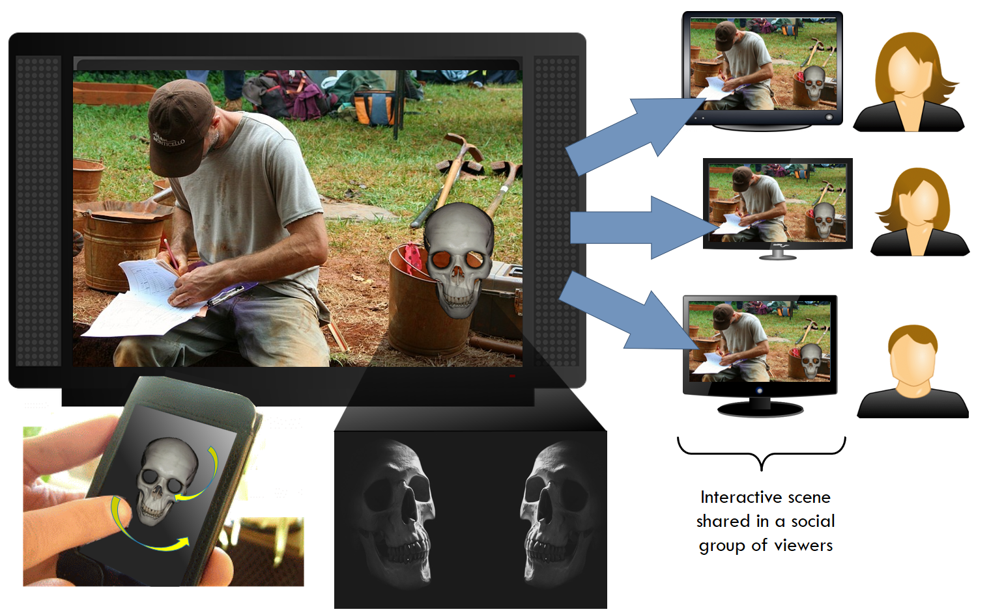
OBJECT-MEDIA: FROM PERSONALISATION TO A SEAMLESS TV/VR convergence
From Interactive TV … Towards a Seamless TV/VR Convergence
Viewer Interaction with the Media Objects
Object-based video (and audio) allows placement of individual video and audio items into a specific position and timing of the video playout.
Object placement is by simple scene graphing vectors. So with simple feedback, e.g. from an app, the user can interact with vector data to reposition the object. This is detailed in the delivery platform description here.
Applications include interactive entertainment and gaming, and exploring products for immersive advertising.
Online colleagues can be connected with the same data will also receive the object vectors and so realise a shared experience.
The Broadcast VR Experience
Object-based video is an intermediate format between TV and VR and provides a convenient platform for the viewer to transition from a 2D TV playout to a fully immersive VR experience.
This opens up a path of convergence between personalised, interactive broadcast TV and VR (with the same collaboration, interaction and personalisation).
This convergence between TV and VR is discussed further here.
Interactive scene shared in a social group of viewers
Return to …
Introduction and overview
Home page

Slide 7
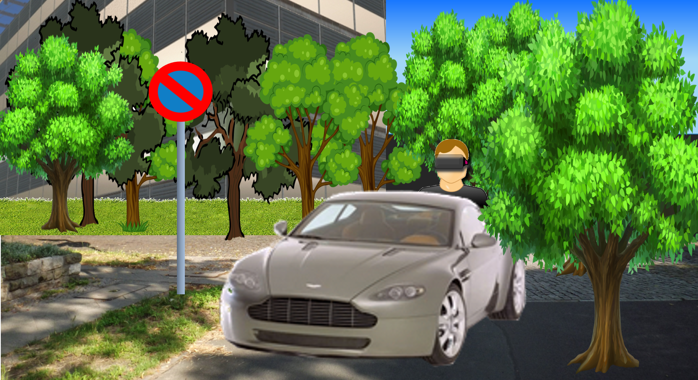
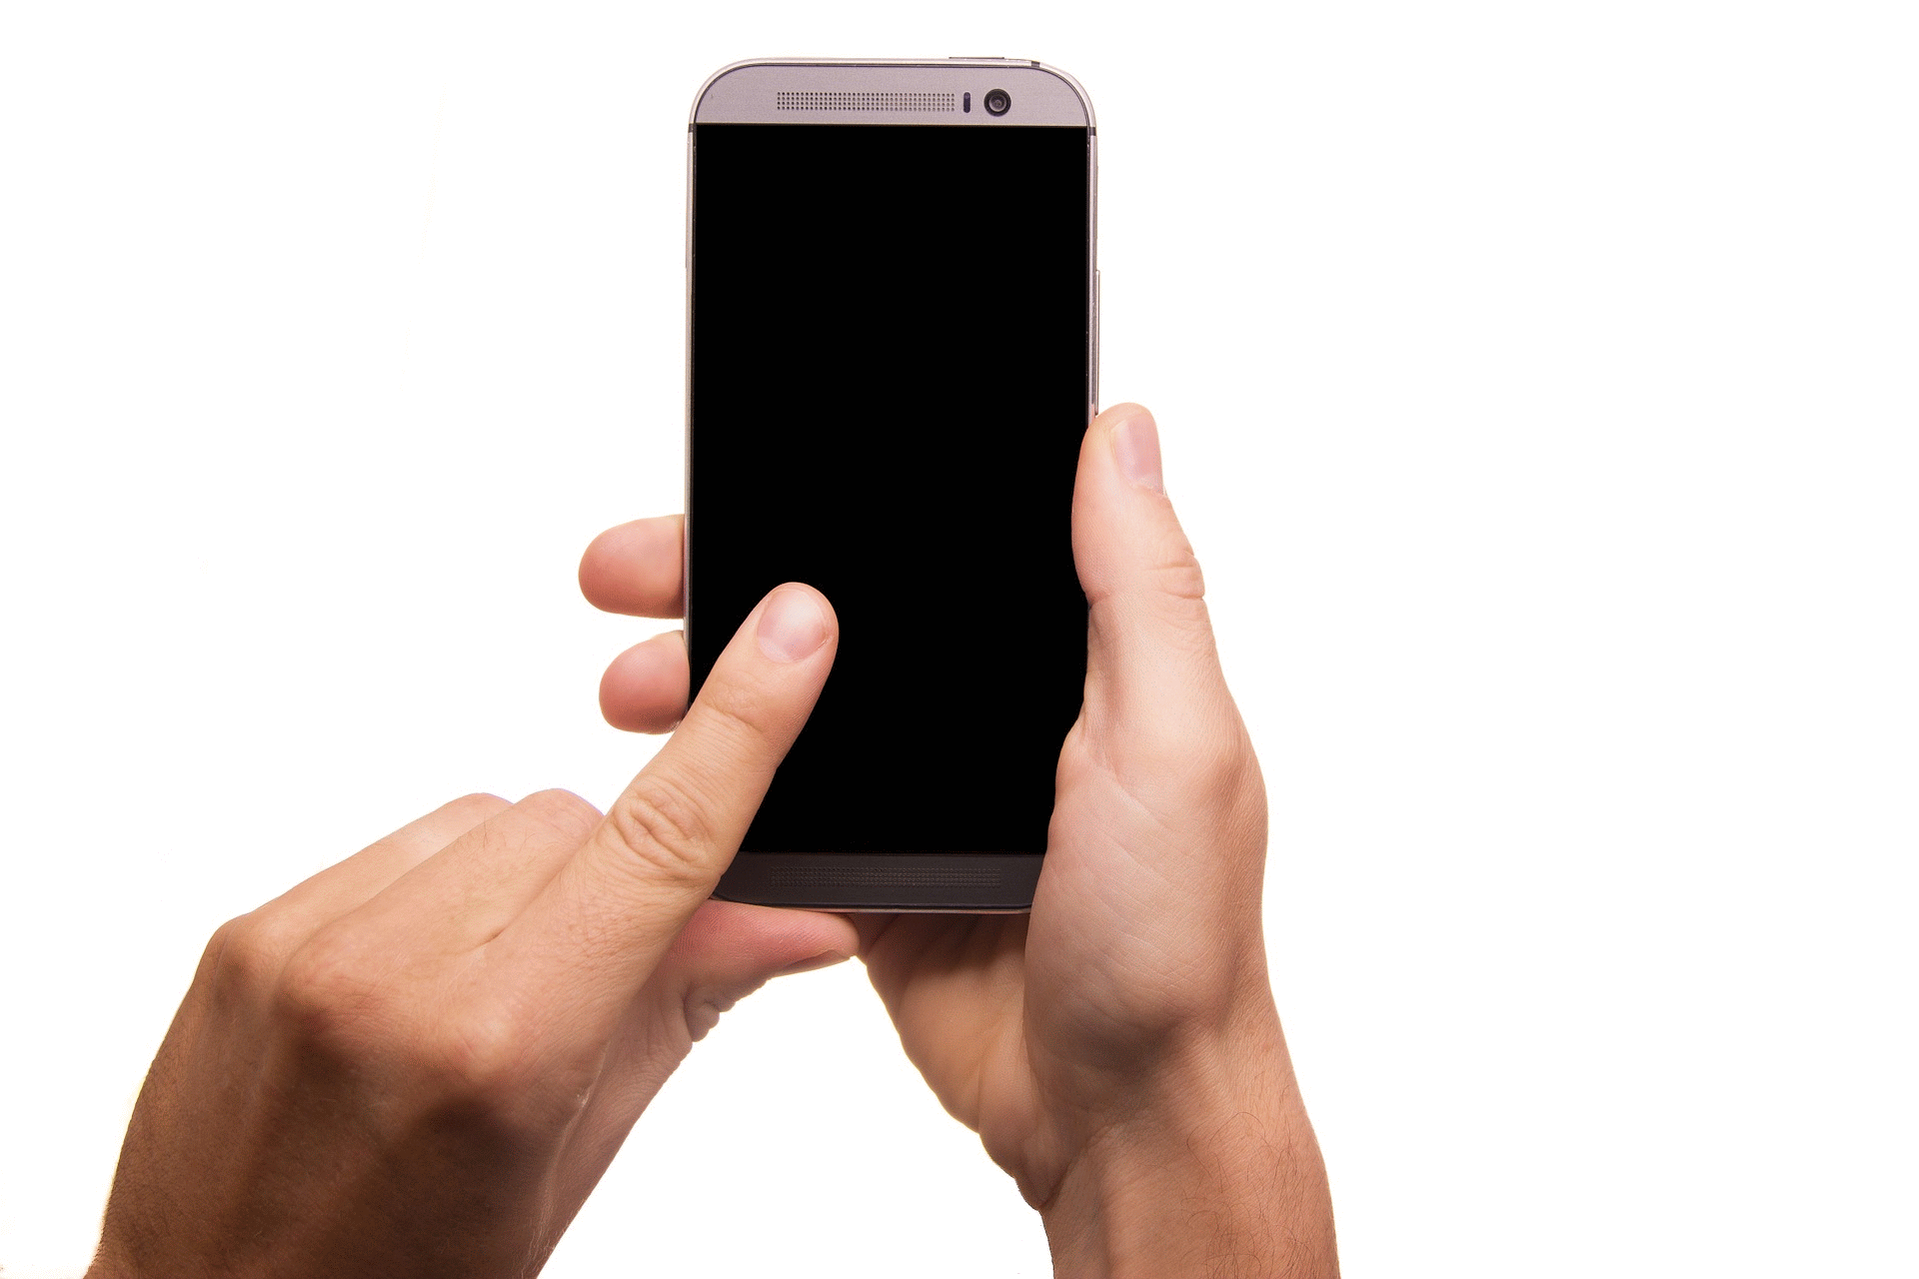
OBJECT-MEDIA: FROM PERSONALISATION TO A SEAMLESS TV/VR convergence
TV ⬄ VR Seamless Services
Video Server
Linear TV with object placements; viewer initiates VR session.
Objects may be transitioned from TV to VR world.
VR Server
The technical vision here allows a tight integration and seamless services between TV and VR worlds. Shared, interactive and personalised activities can be experienced by a range of collaborators using both platforms, and for a variety of programme types - entertainment, education (e.g. personalised interactive documentaries), accessibility, etc.
TV to VR “Breakout”: One method of achieving this is for the production to allow the viewer to choose to “break out” from a TV program and initiate the full interactive 3D experience, and allow the viewer to explore the virtual world. For example advertising messages become much more informative when the viewer is allowed to explore, say, the cockpit of a sports car. VR can also add an understanding to abstract products, for example, to explore the time and monetary values of a savings plan.
Advertising and Brand Awareness: As discussed in How webVR is going to change brand experience we are looking towards VR bringing brand awareness. With a close relationship with TV, we can deliver a tighter integration of advertising and programme content, and build in shared-viewer advertising.
Social Media: Sharing User Media (Objects): The experience can also allow user generated media objects to be fed back into the VR world and shared with collaborating colleagues, and that this could be linked with the collaborators’ social network activities, photo uploads, etc.
Return to …
Introduction and overview
Home page
How webVR is going to change brand experience – Nicolas Monnoyer
(to link to this, see the online presentation, url in the QR code, below)

Slide 8
OBJECT-MEDIA: FROM PERSONALISATION TO A SEAMLESS TV/VR convergence
Delivery Platform
Headend
Cable, Satellite, DTTV …
Viewer
Video Server
The proposed architecture supports in-video personalisation with object placements; interaction with those placements (if allowed by the production); initiation of a VR session relating to the video programme.
The distribution solution addresses all delivery platforms – DVB cable/satellite/terrestrial and IPTV/OTT. The network equipment requires little additional infrastructure – mainly (i) the object libraries (ii) the Scene Server; both of these elements are based in the web.
The platform is therefor an advanced version of a Hybrid Broadcast Broadband (Hbb) solution.
We are currently addressing pre-rendered personalisation from cloud-based playouts.
CLICK HERE to continue the description of the platform
WWW
Return to …
Introduction and overview
Home page

Slide 9
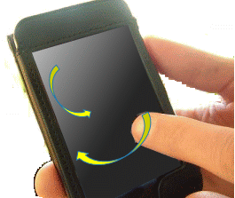
OBJECT-MEDIA: FROM PERSONALISATION TO A SEAMLESS TV/VR convergence
Delivery Platform – 4 – VR Broadcast and Personalisation
Delivery Platform – 3 – Interaction
Delivery Platform – 1 – Standard Video Playout
Delivery Platform – 2 – In-Video Personalisation
Headend
Cable, Satellite, DTTV …
Viewer
DVB
IPTV
Source Video (DVB)
Video Server
Source Video (IP)
Profiling
Viewer feedback, information, etc
Selected Objects
Object Selection
Object Libraries
(Synch / Correlation)
Phone App
Scene Graph
Personalised Scene Graph
Scene
Server
Viewer Interaction
Initiate VR session
and VR interaction
VR Server
Selected Objects – Personalised Virtual World
Source Virtual World
WWW
WWW
WWW
VR Platform
The viewer can use an app to send simple data back to the Scene Server to modify the vectors of the placement objects, and so interact with the placement object.
This data can be shared with a number of colleagues online and so realise collaborative interactivity with content personalised for the group, and within a broadcast video (potentially real-time) CLICK HERE FOR NEXT
The viewer’s profile is used to select an appropriate placement object from a library. The object is delivered (via IP/WWW) to the viewer STB for rendering in to the source video
The Scene Server calculates and serves the scene graph relates the object placements to the source video (in terms of spatial placement, time of entry, etc). CLICK HERE FOR NEXT
At specific points in the playout, the viewer may initiate a download of the associated VR world relating to the broadcast video. The VR world may include personalised objects, and interactive, as described above
CLICK HERE TO RETURN
This is a standard video playout, using either DVB or IP networks.
Now let’s personalise this video for the viewer … CLICK HERE FOR NEXT

