Slide 1
Student Midwives: Perceptions of Organisational Culture & Experiences in Practice – The Learner & Future NHS Workforce.
Lisa Jesson, Associate Professor & Head of Department for Midwifery. Professional Doctorate in Education student at Birmingham City University.
Notes:
I am a second year EdD student at BCU and have recently undertaken a pilot enquiry as part of the work toward my area of interest for my thesis.

Slide 2
Background: Organisational Culture
Insidious culture
  Poor outcomes
  Morbidity and mortality
  Patients and service users
  Need for urgent sustained improvement
  A problem for decades
    Department of Health 1989, 2000, 2013, Kennedy 2001, The Kings Fund 2014
So…..
What is the impact on students in the clinical learning environment?
Notes:
Organisational culture has developed into a ‘buzz term’ and has been attributed with a significant proportion of the blame in a number of reports and inquiries across the National Health Service (NHS). These reports have highlighted poor outcomes and the need to improve the culture within the NHS (Department of Health 1989, 2000a, 2000b, 2000c, 2013, Kennedy 2001, The Kings Fund 2014). These publications focussed on the patient or service user, in terms of poorer outcomes, specifically morbidity and mortality, linked to an insidious organisational culture. As a midwifery educator, this is of significant concern, however it is of equal concern that there is a lack of recognition of the potential effect organisational culture may have, in respect of the impact on healthcare students.
A negative organisational culture impacts upon the patient experience and outcome (Glisson 2007). This has led the author to question what the impact of this might be on the student, this is of significance given that student midwives are required to spend a minimum of 50% of the programme learning in the clinical setting (Nursing and Midwifery Council 2006). If a negative organisational culture is apparent, then it may be pertinent to consider what specific impact this may have on student midwives in relation to their perceptions of organisational culture and the potential effects on them as learners and future members of the NHS workforce.

Slide 3


Existing Evidence
              Belonging
              Self-view
              Newcomer
              Adaptation
              Socialisation
              Dilemmas
(Monrouxe & Rees 2017, Houghton 2014)
Notes:
There are some powerful motives at play which may result in a student not speaking out & sharing a bad experience with their tutor, e.g. the power that mentors have when assessing students as safe (Kennedy 2001). Rafferty et al (2015) stated that we need to recognise the role that organisational culture has in influencing the experience of patients, service users and staff.
The desire to inform change in the NHS should include positive change for students. It is evidence that that there is a need to work towards developing a culture that fosters learning, so that students in the practice setting are not disadvantaged in terms of being supported to reach their potential. Tackling poor organisational cultures has been raised as an issue for decades, and with the forthcoming changes to funding for healthcare students, with the removal of NHS bursaries, this is more important now than ever.

Slide 4
Research Question, Aims and objectives
Explored student midwives perceptions of the culture within clinical placement settings and considered whether the student perceived this culture to be positive or negative, based upon what they know about organisational culture.
The effect on their experience as a learner in the clinical setting.
The effect on how they see themselves as a future member of the NHS workforce.

Slide 5


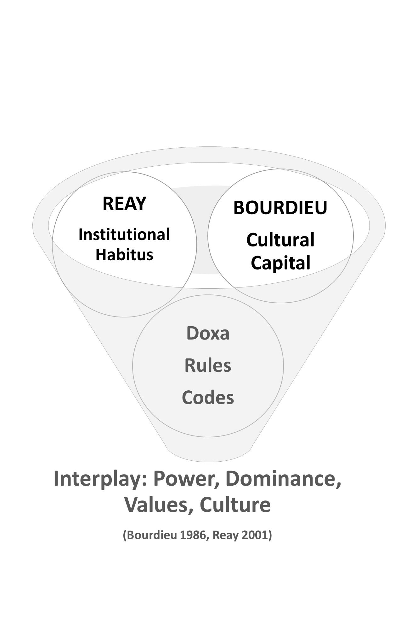





Notes:
The theoretical frameworks underpinning this study are associated with the work of Bourdieu (1986) and Reay (2001) and are linked to the theory of cultural capital, institutional habitus and doxa. Exploring the codes, rules and institutional impact on the student affected by the interplay of power and potential domination of mentors and qualified staff over students.
The research methodology sits within the constructivist paradigm and is qualitative in design using a phenomenological approach as a means of inquiry.

Slide 6
Data Collection
Two participants
2nd year student midwives
In-depth interviews
Open ended questions
Data Analysis
Content analysis
Coding
Categorising
Main themes
Theme reduction
Over-arching key themes
(Corbin & Strauss 2008)
Notes:
Two participants took part in in-depth interviews, using open ended questions.
Participants were recruited from the year 2 of a BSc (Hons) Midwifery cohort as they were considered to have had exposure to a variety of placements and could provide rich data.
Data analysis was carried out using the approach of content analysis including coding and categorising, identification of main themes, theme reduction and finally identification of overarching key themes.
Content analysis, including coding and categorisation will identify central messages, member checks will add to validation & triangulation (Corbin & Strauss 2008).

Slide 7
Research Findings
Fitting in
Emotional challenges of negativity
Dealing with hierarchy & barriers
Keeping an open mind
Personal growth & character building
Strength in commitment
Notes:
Findings elicited the key themes were the concepts of fitting in, emotional challenges of negativity, dealing with hierarchy & barriers, keeping an open mind, personal growth & character building, strength in commitment.
These are some examples of what the students said….

Slide 8
Fitting in
“Sometimes as a student I am confused about what to do… I end up doing the same as my mentor so that I can fit in. The environment and the atmosphere make a difference and you have to work out a mentor's personal preference about practice even when it isn’t evidence based.” – student A
“I’ve had more positive than negative experiences, I felt proud to be part of the team, not just the student, not a dog’s body which I have experienced in the past on …. ward.” – student A
“When you don’t fit in you feel like a part of the furniture and stick out”. – student A
“I was filled with a sense of being important and valued around the midwives.. being part of the team”. – Student B

Slide 9
Emotional challenges of negativity
“”When the culture is positive I feel happy, I had better continuity with my mentor I learnt a lot more really… when it was bad I struggled to get up and go to do a shift. I didn’t use my skills and felt useless. My stress was high, I could see how they (Midwives) were and though to myself ‘do I want to be like that in the future?’. I should not be stressed as a student but dreaded going in… “. –Student A
“I saw another student crying and she told me a midwife had been nasty to her.. I felt like I should say something but didn’t…I’d like to think that I would say something next time”. –Student A
“A midwife made me feel stupid ..just about getting the wrong cup for a woman to have a drink, it was silly really, she dealt with me angrily. I walked away and felt it was unacceptable and unnecessary… I went back to challenge her but she’d gone…it stays with you and leaves a mark…it’s horrible”. Student B

Slide 10
Dealing with hierarchy & barriers
“The hierarchy has a big impact, only 1 consultant has ever taught me on the ward. He’s the one who has lunch with the staff too …the others don’t do that. I don’t have the confidence to ask questions.” –Student B
“It affects team working…my confidence is lower when asking a band 7 a question. They expect me to know who staff are and made me feel stupid…I was told by a band 7 to help take a patient to theatre and she shouted down the corridor at me, now I dislike that person”. – Student B
“I have a fear of getting something wrong and dreaded asking a question”. Student B
“It’s not everyone, just the one’s with egos. They think they are better than you are…it was worse as a 1st year, now I know more as a 2nd year it’s not as bad as I’ve moved up.” Student A
“Word gets around and when you know a midwife is bossy or unapproachable you have to try not to listen to gossip …this affects their reputation”. –Student A

Slide 11
Keeping an open mind
“I always take something from a placement even when it’s negative (the ward) …learn how not to do it as well as how to do it.” Student A
“I try to keep an open mind when I hear something about a bossy midwife or a bad one (midwife)…I dread coming across them as my mentor but it’s not fair on them, word gets around but they might be alright”. Student A
“Before I started the course I thought that midwives were happy and jolly, but the reality was that they were downtrodden and depressed on the first ward. I tried to think that not everyone is like that and everyone is different”. Student B

Slide 12
Personal growth & character building
“I can see my own growth especially when I’ve had a good mentor and placement, I lean a lot more and the staff thank me”. Student A
I want to make a difference to the women,…I’m thinking about the future and not letting it destroy that”. Student B
“I am trying to be a better midwife than the bad mentors….you have to look at the bigger picture and not let it ruin things for you”. Student B
“I take the good bits from midwives and leave the bad bits…become the midwife I want to be”. –Student A
“My professional integrity and responsibility keeps me going…it’s of paramount importance to me.” Student B

Slide 13
Strength in commitment
“I’d like to think I will be better …I’m still excited to be a midwife and still committed to it”. Student A
“I could get depressed with the pressures but it’s not happened to me…personal growth is important…I’ve took a bad experience and made it positive …this liberates you as a person”. Student B
“I am focussed on being safe in my own learning not the negative stuff. What is important is how I am towards them not how they are towards me…I try to show them the right way by being polite myself.” Student B
“I have never wanted to leave the programme…I am strong minded and try not to let their behaviour affect me. I try to stand up for what I believe in.” Student B

Slide 14
References
Bourdieu, P. (1986) In Szeman, I. Kaposy, T. (2011) Eds. Cultural theory: An anthropology. Chichester: Wiley Blackwell.
Corbin, J. Strauss, A. (2008) Basics of qualitative research: Techniques and procedures for developing grounded theory. 3rd Edition. Thousand Oaks: California.
Department of Health (1989) The White Paper - Working for patients NHS Reforms. Cm 555. London: HMSO.
Department of Health (2000a) An organisation with a memory: Report of an expert group on learning from adverse events in the NHS. London: HMSO.
Department of Health (2000b) Shifting the balance of power within the NHS: securing delivery. London: Department of Health.
Department of Health (2000c) The NHS Plan: A plan for investment, a plan for reform. Cm4818I. London: HMSO.
Department of Health (2013) Hard truths: The journey to putting patients first. Government response to the Mid Staffordshire NHS Trust Public Inquiry. London: Department of Health.
Houghton, C. (2014) Newcomer adaptation: A lens through which to understand how nursing students fit in with the real world practice. Journal of Clinical Nursing. 23(15-16): 2367-2375.
Kennedy, I. (2001) The report of the public inquiry into children’s heart surgery at The Bristol Royal Infirmary 1984-95: Learning from Bristol. London: Department of Health.
Monrouxe, L.V. Rees, C.E. (2017) Healthcare professionalism: Improving practice through reflections on workplace dilemmas. Chichester: Wiley Blackwell.
Reay, D. (2001) It’s all becoming a habitus: beyond the habitual use of habitus in educational research. British Journal of Sociology in Education. 25(4) 431-444.
The King’s Fund (2014) Culture and leadership in the NHS: The King’s Fund 2014 survey. London: The King’s Fund.

