Slide 1
“It’s all smoke and mirrors,
but I voted anyway”
Dr Rebecca Semmens-Wheeler
Birmingham City University/Centre for Brexit Studies
Dr Kimberley Hill
The University of Northampton

Slide 2
Overview
What the Brexit?
Voting Preferences & Trends
Initial Brexit Research
Our methods: Quantitative & Qualitative
Key findings
Discussion

Slide 3
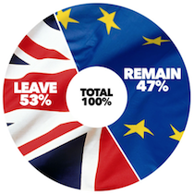
What the Brexit?
1973: Britain joined the European Community
June 2016: Referendum on EU Membership
Turnout of around 33,000,000 people (72.2% of voting population)

Slide 4
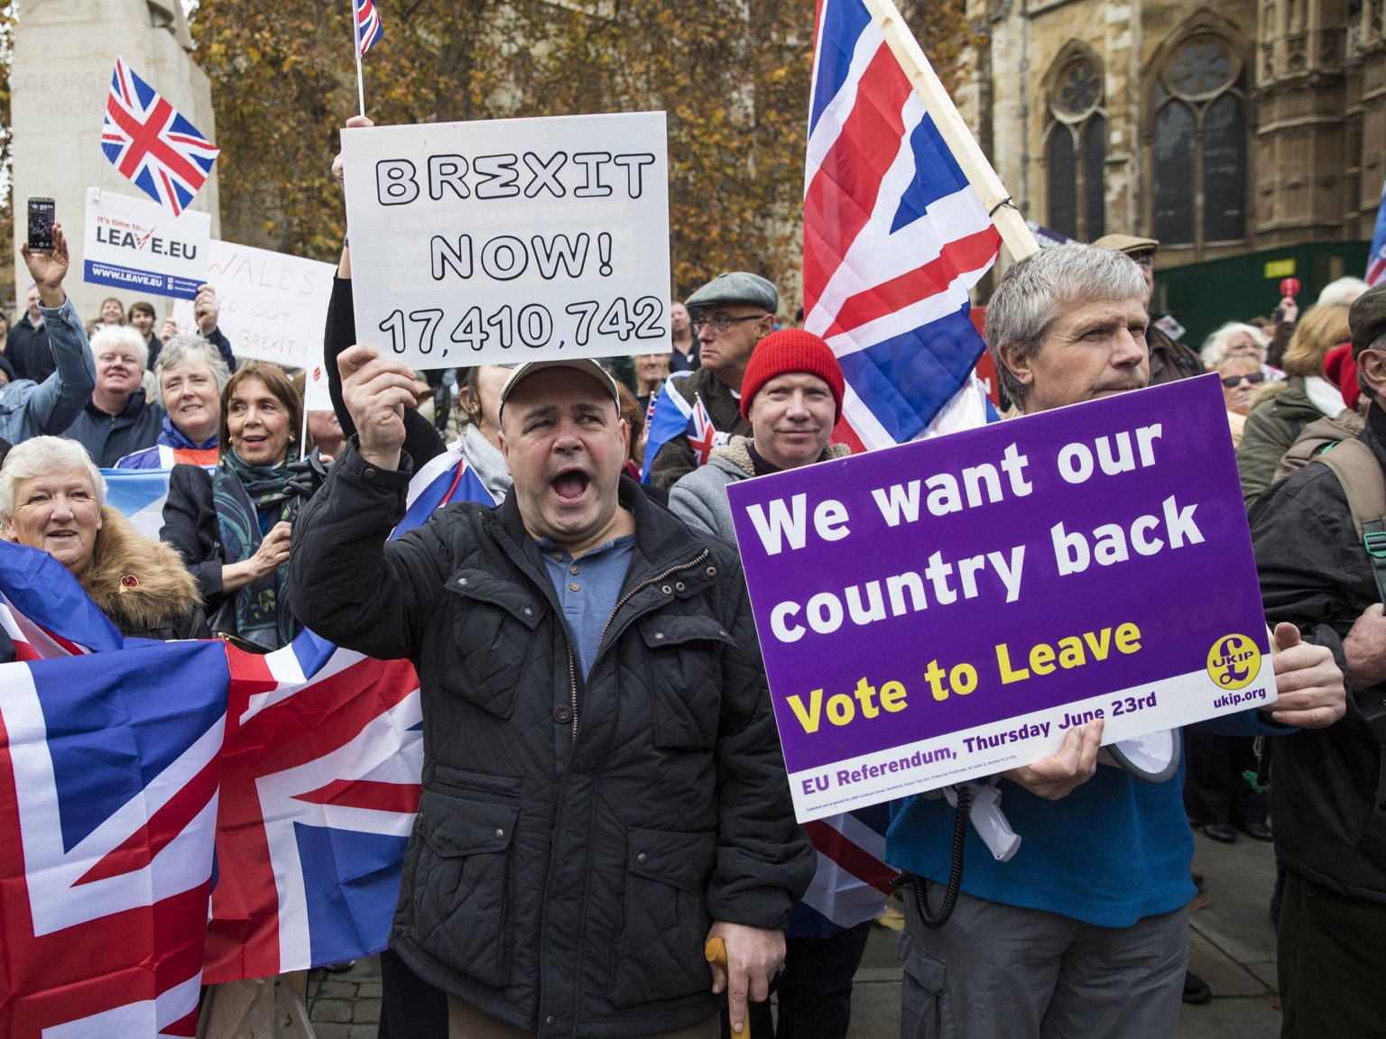
Initial Post-Brexit Research
“The divide between winners and losers of globalization was a key driver of the vote.”
Views against immigration &for the death penalty predict voting out - right-wing authoritarianism
Notes:
This is a visually appealing slide
Leave votes common among less-educated, poorer and older voters, and those who expressed concerns about immigration and multi-culturalism (Hobolt, 2016)
Immigration & death penalty predict voting out – speaks to right-wing authoritarianism, or “openness vs order”.
“Karen Stenner, author of the Authoritarian Dynamic, argues that people are divided between those who dislike difference – signifying a disordered identity and environment – and those who embrace it. The former abhor both ethnic and moral diversity. Many see the world as a dangerous place and wish to protect themselves from it.” – Economic divides may be overshadowing differences in identity and personality, which are more realistic predictors of voting behaviours.

Slide 5
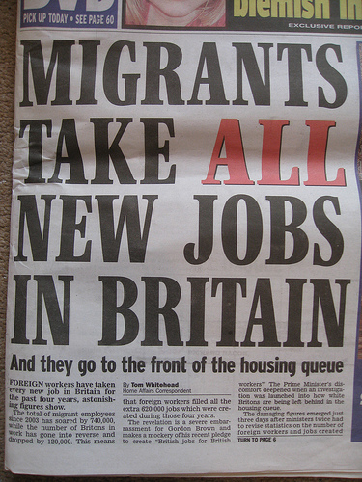
Initial Post-Brexit Research
Anti-immigrant prejudice and negative intergroup contact associated with voting to leave
Positive intergroup contact - lower prejudice and support for ‘remain (Meleady et al, 2017)
Aversion amplification hypothesis - Voters most likely to choose Brexit when concerns that immigration levels were too high were combined with a low level of trust in politicians (Abrams et al, 2015).
Notes:
Voters were most likely to reject the political status quo (choose Brexit) when concerns that immigration levels were too high were combined with a low level of trust in politicians.

Slide 6
Locus of control
External locus of control has been shown to promote more anti-immigrant attitudes, which are distinct from, but related to, racial prejudice (Harell, Soroka & Iyengar, 2016).
Those with lower income tend to feel politically excluded and experience having less control over socio-political issues (Dunatchik et al, 2016).
Notes:
I like these slides, but wondered if we need separate slides on these – perhaps just one slide stating what each one is and the questionnaire we are using to mention it?

Slide 7
Social Dominance Orientation
The extent to which one desires that one's in-group dominate and be superior to outgroups
Preference for hierarchical organisation of groups
Inversely related to empathy (Nicol & Rounding, 2013)

Slide 8
Collective self-esteem
People high in this trait
Feel esteemed about groups they’re part of
Are more likely to react to threats to collective self-esteem by derogating outgroups and enhancing the ingroup
Notes:
People who are high in trait collective self-esteem should be more likely to react to threats to collective self-esteem by derogating outgroups and enhancing the ingroup.

Slide 9
Losers of globalisation – external locus of control?
Geography of discontent
Feeling disenfranchised
Feeling of having no control over anything
Notes:
See comment on previous slide

Slide 10
Methods
Surveyed 366 participants from across the UK - Qualitative and quantitative questions
Qualitative interviews
Vox Pop data gathered from leave-voting areas during the “Brexit Roadshow”

Slide 11
Our Sample
Age: 18-82 years old (M = 27.65)
83 males, 266 females, 12 other
233 (61.8%) students
EU Referendum Vote
Vote | Frequency | %
Remain | 199 | 55.12%
Leave | 100 | 27.42%
Did not vote | 63 | 17.45%
2015 general election:
143 voted Labour (39.6%)
80 did not vote (22.2%)
74 voted Conservative (20.5%)

Slide 12
Demographics: Employment status
Notes:
Can we collapse some of these into one or two slides?

Slide 13
Demographics: Education level

Slide 14
Demographics: Vote in referendum

Slide 15
Methods: Survey questionnaires
Locus of Control scale (Rotter, 1966)
Social Dominance Orientation scale (Pratto et al, 1994)
Modern Racial Prejudice scale (Akrami et al, 2000)
Decision Making Questionnaire (French et al, 1993)
Social Self-Esteem scale (Crocker & Luhtanen, 1990)
Empathy: Interpersonal Reactivity Scale (Davis, 1980)
Notes:
Do we need a separate slide for this?
Or can this be combined with slide 11 above?

Slide 16
Empathy
Collective self-esteem
Locus of control
Social Dominance
Orientation

Slide 17
Qualitative survey questions
How did you vote…. What were your main reasons for voting (or not voting) this way? ….. Please explain more about your reason here.
How do you feel now about the way you voted in the EU referendum?
Please type anything you'd like to add about your reasons for voting this way, or for not voting.
Notes:
Do we need this here – can we just mention today we are focusing on the first one?
What were your main reasons for voting (or not voting) this way? …..
UK trade and economy will suffer if we leave the EU.
We don't want to lose protective legislation (e.g. equal pay, parental leave, bans on discrimination) by leaving the EU.
The cost of living will increase if we leave the EU.
Quality of life will be better if we remain in the EU.
There is a greater risk of war if we leave the EU.
Holidays in Europe will be more expensive.
Job prospect
We give too much money to the EU.
We have no control over what the EU decides about immigration.
We won't have to deal with EU regulations if we leave.
The UK needs to reclaim its sovereignty.
I couldn't decide what the best decision is.
The EU is undemocratic, as we do not elect leaders there.
I didn't think my vote will count.
The welfare system will be fairer if we leave.

Slide 18
We’re not happy and no-one is listening
Leavers’ Voting Reasons:
1.
Dissatisfaction within existing UK political and social structures
An opportunity to register personal protest
Limited trust or conﬁdence in the people in power who are meant to serve them
Disunity within the ‘leave’ camp
“I was not happy with the things that were happening, but knew things needed to change”
“It’s all smoke and mirrors, but I voted anyway”
“I don't think our politicians are listening to the people”
“I don't tell anyone since they think I'm a racist”
“…control of our borders is vital!”
Notes:
Although many did not think they had the power to elicit change. Voters were not misinformed, although often sought out information from others/ went on a gut feeling, often feeling as though their vote would not make a difference, as vote had already been set
Distrust in those running the country and no-one is listening to their concerns – similar to some of the remainers (misleading/ irrelevant information presented by the gov)
Shamed/ isolated remainers: Some did not identify with racism, xenophobia etc. or other polarised reasons for vote attributed to them by politicians, the media and other members of society. Often kept voting preference to self. Realise migration a big factor in many other people’s decisions to leave the EU and focused on cultural recognition, but felt their reasons were more complex) Others were proud remainers:. Trying to understand the way that others see them.

Slide 19
Leavers’ Voting Reasons:
The EU is unfit, unfair and will fail
2.
Concern about economic distribution, precarity and austerity within the EU
“…use the money to invest in our country and the people who need it”
Focused on limited economic resources and deprivation
Presentation of the EU as outmoded and no longer fit for purpose
Controlled immigration as a means to address austerity
“The EU will implode before it changes its’ attitudes”
“…well intentioned, but it morphed into a bureaucratic monster”
“We cannot afford to keep taking on immigrants, we have homeless people, people not getting health care, education or being able to eat”
Notes:
The need to help Britain not the EU, particularly in areas such as healthcare and the NHS
Presentation of the EU as outmoded and no longer fit for purpose (EU a thing of the past, unsuited to the new era) – similarities to some of the remainers here, but also the sense of unfairness of our position compared to other members of the EU – we follow the rules
Ensure fair distribution of resources, while making the UK safer and ensuring social integration. View migrants or refugees as a symbol of what is wrong with the EU

Slide 20
Short-term hardship for long-term benefits
Leavers’ Voting Reasons:
Take the power back
3.
Short-term pain for long-term gain
“Short-term it will be difficult, I voted leave for the long-term gain, such as for my children's children”
Short-term hardship for long-term benefits
Protection and reclaiming of national sovereignty
“It should not be for other countries to decide how our country is run”
“Young people will experience the country as it was when our grandparents were young”
“I think it is time that the UK claim back some control”
“Make Britain British again”
Notes:
Many considered a cost-benefit analysis, happy to go through hardship in the short term to ensure future/ younger generations are better off
Taking back control, making own independent decisions and laws which suit the country’s interests. Reclaiming power

Slide 21
Better Together
Remainers’ Voting Reasons:
1.
The EU as a symbol of strength and unity for our common future
“The EU protects us, alone we are a target”
“England is so small why make it seem even smaller”
Protective factors of the EU, particularly in times of conflict
Concern about isolation and vulnerability on a global stage
Improving the EU together from within
“The belief that we are strong enough alone is misplaced”
“You can't create change if you're not involved”
“It is easier to make changes to something if you are part of it rather than on the outside”
Notes:
Ideals of cohesion and unity (cohesion, unity of working as one, having a world view.
fear of exclusion, isolation or vulnerability from rest of world, but protective factors of EU, as well as safety and security, particularly in times of conflict/ threat.
awareness of limitations of EU, but better to change EU from the inside, based on what you know. Better the devil you know, how always been, now a step backwards and times will change.

Slide 22
Fear for the Future
Remainers’ Voting Reasons:
2.
Ongoing concern for the long-term implications of Brexit
“I still do not see how leaving the EU is a good idea”
“I identify as European and value being part of Europe”
Detrimental impact on the economy, legislation and freedom of movement
Concern for the future generations and those without a voice
Loss of cultural diversity and our European identity
“The EU provided protection for people without an adequate voice in society”
“A lot of the things that EU law protects will be stripped away”
“An economic no-brainer to remain”
“Leaving the EU is a backward step”
Notes:
Considerations of impact (mainly economy, legislation and freedom of movement, but complex reasons provided about other areas. E.g.: economic risk of Brexit, economic stability/ benefits/ wellbeing if stay in EU, also related issues around expenses, single market, customs, living costs, recession. Then freedom of movement, impact on travel and holidays, travel, trade, employment and job prospects, human rights laws, EU funding for community projects in jeopardy. Issues with protective legislation, equal rights, lower life quality, research, house prices, scientific co-operation. Immigration, nationality, visa also an issue. Surprisingly environmental protection not an important factor, although mentioned by a couple of participants.
Concerned about those without a voice, working class, younger generation (and non-voters?), vulnerable others, as well as the future of the UK. Many were of the younger generation, or felt the younger/ future generations would suffer.
Felt diversity/ culture positive and many identified as European.

Slide 23
Left on a Lonely Island
Remainers’ Voting Reasons:
3.
Making sense of the perceived loss of consensus
“leave campaign arguments were inconsistent and sugar coated”
“It’s the fear of the unknown”
Seeking to understand leave voter motivations and related campaigns
Distrust in local and global political decision making
Disunity within the remain camp
“Government can literally screw us over in any way they like, with no one to answer to”
“Left on an island with tory psychopaths”
“A lot of the elderly who voted out, aren't going to be around to see the consequences of their actions.”
“People were wanting to leave for racist reasons or based on lies”
Notes:
CHECK NAME OF THIS THEME WITH RSW
perceptions of leave voters and “othering” (e.g. entitled, elderly, racist, not around to see impact/ consequences of actions, misperceiving information, not informed, not understanding impact, selfish), perceptions of leave campaign (inconsistent, lies, hyperbole about migration/ NHS, over-ambitious, xenophobic, fear-mongering, problematic.
Distrust in local/ global politics (distrust in local/ UK government and their decision making, particularly Tory. Saw UK as being brought down by Gov who would have no-one to answer for and were untrustworthy. No longer felt protected from local Gov who were ruining the country. Also acknowledgement with the rising far-right and alt-right within Europe, but left behind on a global scale. Similar to the leavers, apart from their feeling related to the loss of political consensus .
Disunity between 1) borderline voters acting on instinct, but comprehending referendum outcome. Many borderline voters went with a gut feeling, what felt right, even though some wanted to spoil their vote with a protest vote. Coping with/ comprehending outcome, but uninformed, confusion/ lack of information led to their uncertainty. Lack of information was a key factor, fairness important in outcome. 2) Considered and concerned voters facing regret and future uncertainty. Were cautious in placing their vote and now regretted outcome. Careful consideration of costs and benefits, remain benefits outweighed/ had stronger arguments than the leave arguments, worse off if left. Incomprehension now, devastated pessimists regretted the outcome of the vote, felt fearful for the future. Felt well-informed, lots of information available to make a decision. There was now an uncertain future, stepping backwards into the unknown. Devastated pessimists – regret, fear for future, confusion and future uncertainty, concerns with what happens next. Hope to change vote later on. State here distinction of remainers – may have some common goals, but also differences (lacking in unity and clarity?)

Slide 24
“Leave”
“Remain”

Slide 25
Non-voter Reasons
Could not decide/ not enough information
Did not think vote would count/ make a difference
Could not get to polls/ Ineligible to vote
Not interested
“I don't understand a lot of politics and an ignorant vote is worse than not voting”
“I would love to but by law I couldn’t”
“It didn't matter to me”
“I just didn't see how my vote would make a difference as a whole”
“I did not feel I know enough about the EU to vote”
“I did not vote, to avoid voting for the wrong one”
“Brexit could be the worst or best decision the country has made, I couldn't decide one way”
“Government have final say, voting keeps us quiet whilst they control our lives entirely”
Notes:
Also important here

Slide 26
Summary & Conclusions
Leavers show more racial prejudice, have greater esteem about their own social groups and believe in hierarchy of groups
BUT Leavers are not less empathic than remainers, and are not ‘all racist’ (although concerns about immigration)
Leavers feel they’re not listened to, and want to take back control
Remainers are a more diverse group, but generally fear for the future
Both voter types feel a lack of trust in the government
Notes:
Rich, qualitative, in-depth data required with quantitative scoping data
Helps to understand misperceptions, whilst triangulating data
Leavers not ‘all racist’ – although
Helps to understand misperceptions

Slide 27
Current and future Directions
In-depth interviews with voters
PhD studentship
Longitudinal research on Brexit, as it unfolds
Combining expertise from psychology, sociology and economists
Continued analysis from roadshow and integration of those findings with these
Notes:
Continued analysis from roadshow and integration of those findings with these

Slide 28
Questions?
Dr Rebecca Semmens-Wheeler
Birmingham City University & CSB
Email: Rebecca.Semmens-Wheeler@bcu.ac.uk
Dr Kimberley Hill
The University of Northampton
Email: Kimberley.Hill@Northampton.ac.uk
Prof Alex De Ruyter
Centre for Brexit Studies
Email: Alex.DeRuyter@bcu.ac.uk

