Slide 1
Gender as a geography of power? Emerging findings from university spaces
Dr Kate Carruthers Thomas, Birmingham City University
SRHE 2017: Higher Education rising to the challenge: Balancing expectations of students, society and stakeholders

Slide 2
Gender(s) At Work (2016-2018)
how gender and intersectional factors shape employment experiences and career trajectories within a post-1992 UK university/the academy
narrative enquiry (=50) ‘accommodating complexity…revealing ambiguity’ (Bathmaker 2010, p2) space as ‘a simultanaeity of stories-so-far … place is a collection of those stories’ (Massey 2005, p9)
mapping organisational geographies
complexity, inconsistencies, silences – troubles binaries and normative career metaphors (pipeline, trajectory) which, ‘aligned to male-defined constructions of work and career success … continue to dominate organisational research and practice’ (Bilimoria et al. 20108, p.727

Slide 3
organisational mapping

Slide 4
geographies of power?
science park and academy, both part of a ‘network of specialised places of knowledge production (elite; historically largely male) which gained (and continues to gain) at least a part of its prestige from the cachet and exclusivity of its spatiality’ (Massey 2005 p.75).
male-dominated spaces reflect and provide a material basis for a particular form of masculinity and for the production of knowledge abstracted from the real world
particular dualisms … both support and problematise certain forms of social organisation’.
daily experiences of working in the academy play out in border territory between polarised structures of ‘work’ and ‘home’

Slide 5
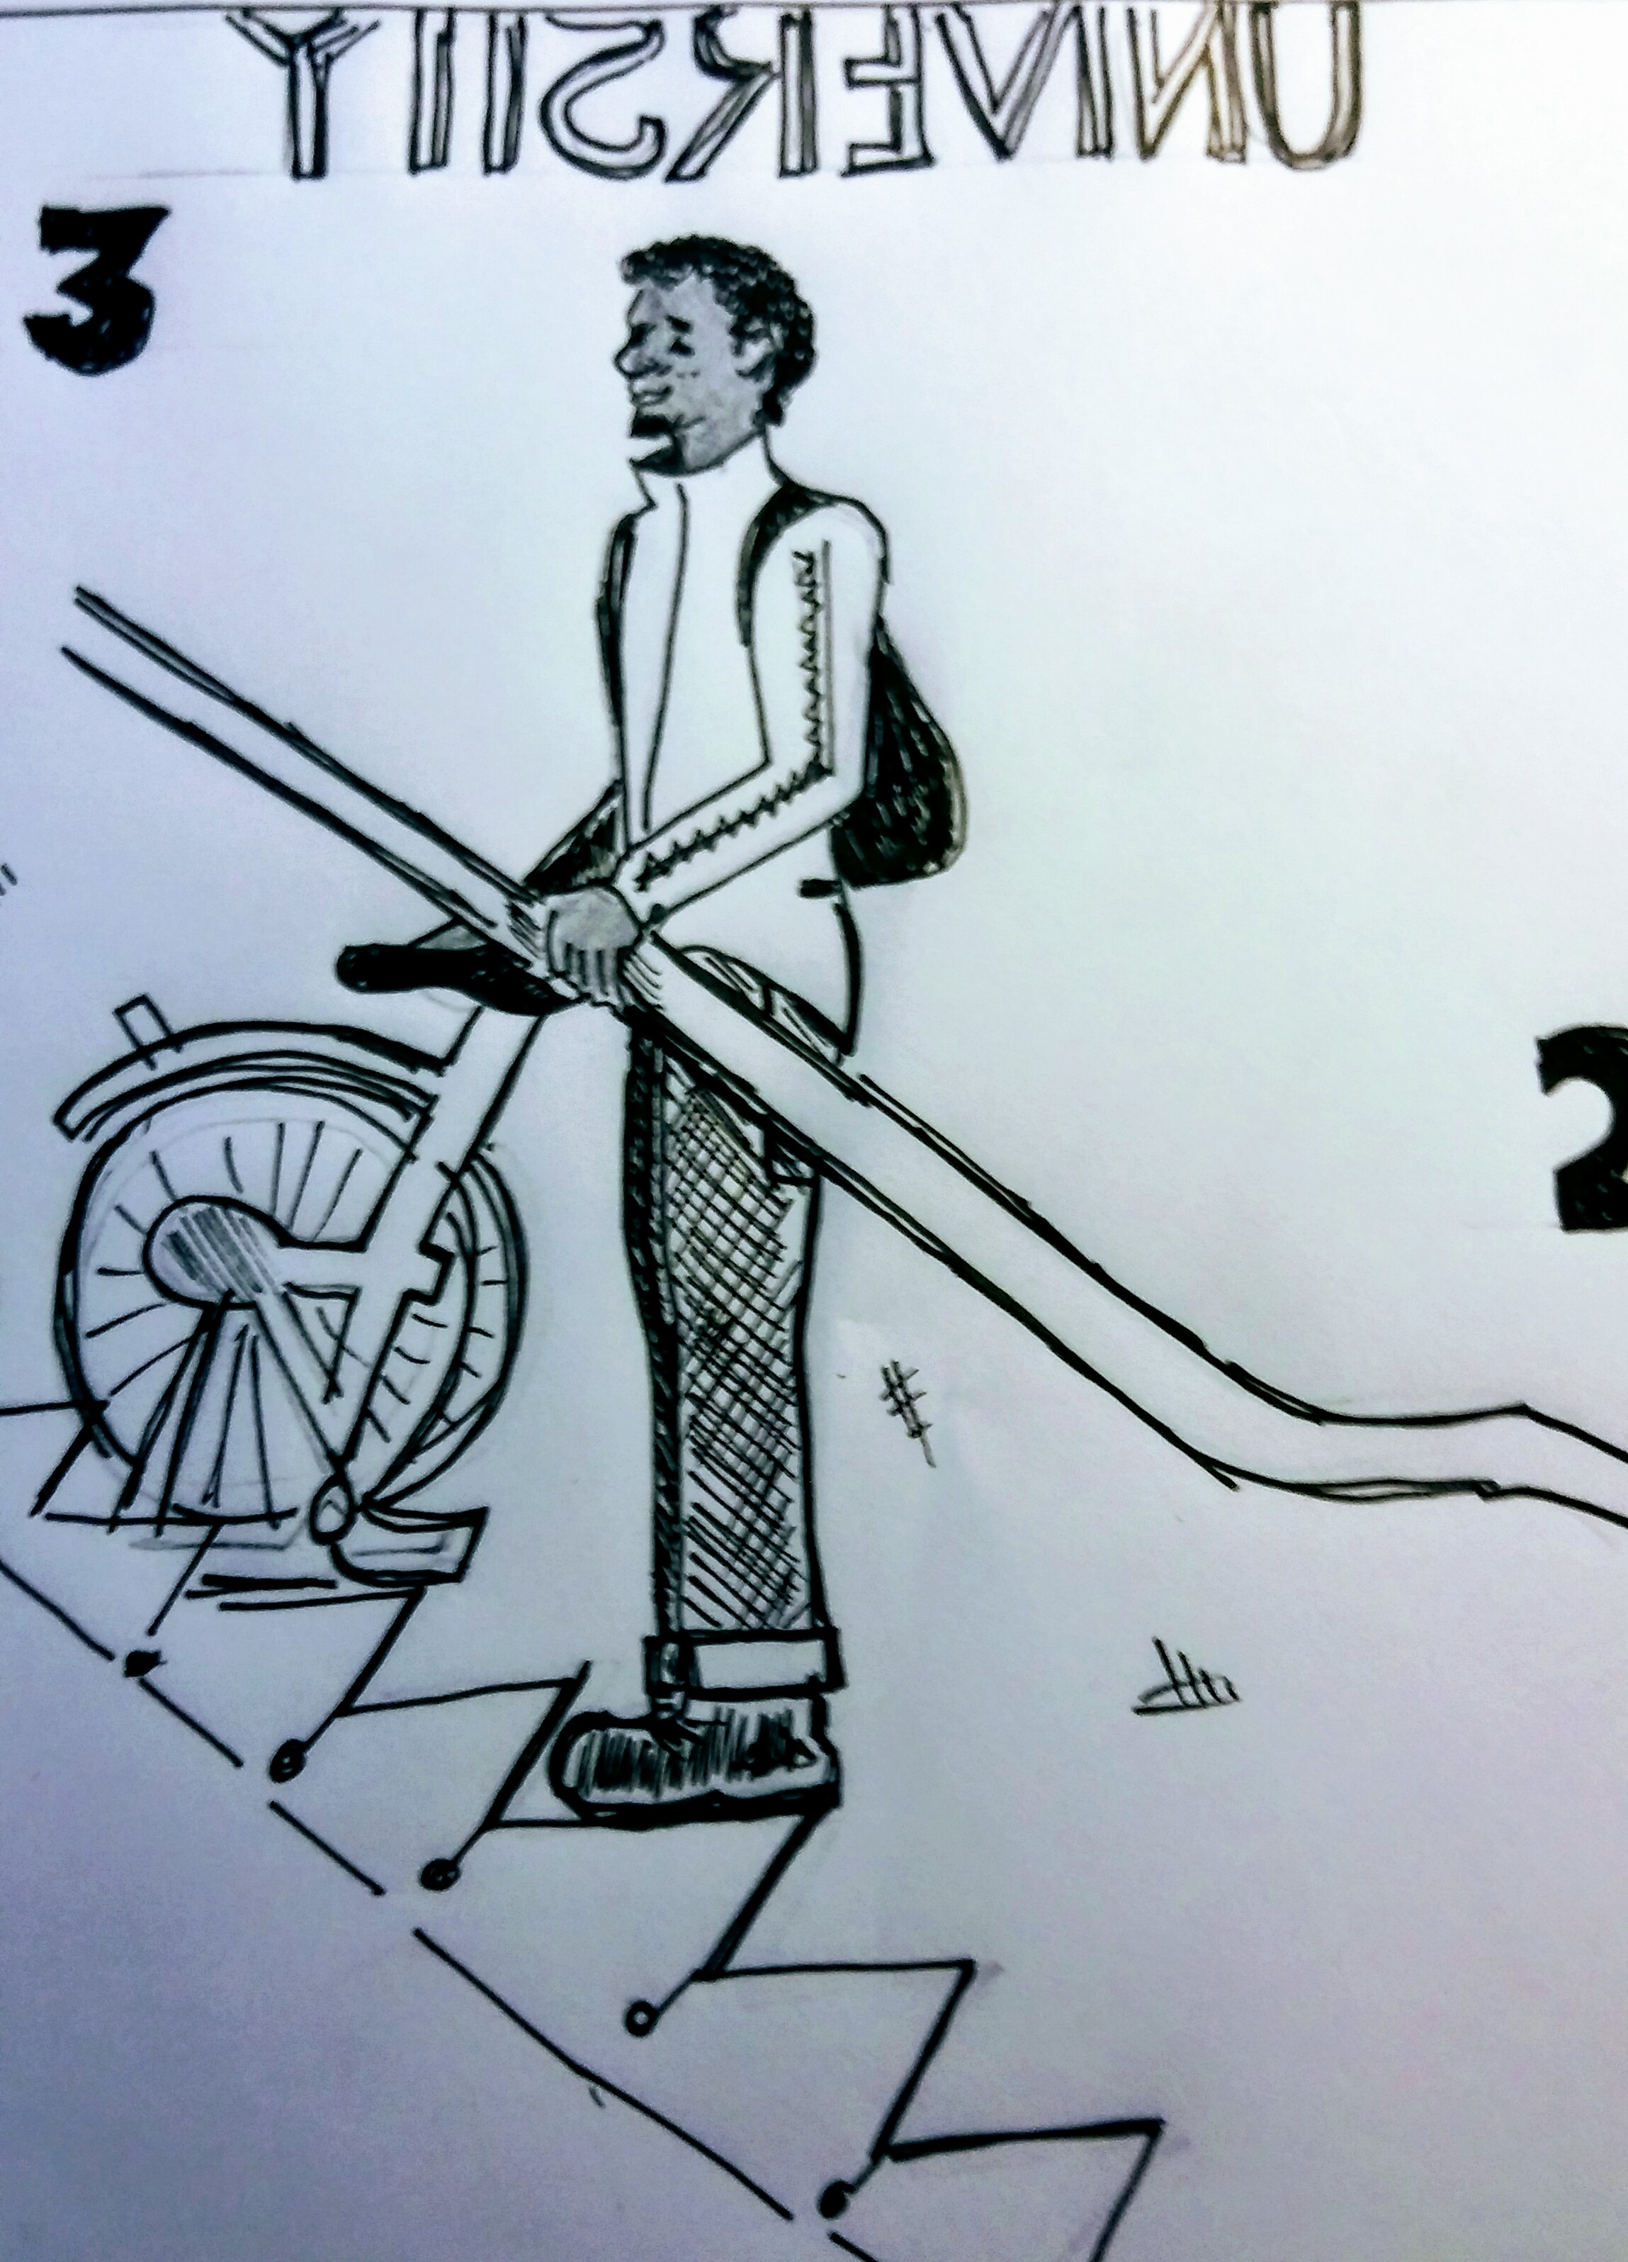
archetypal (architectural?) metaphors of the workplace
(Bruckmüller et al 2014; Williams 2013; Ryan and Haslam 2007; 2005; Budig 2002 inter alia).
Notes:
career obstacles, risks, constraints and privileges frequently characterised by archetypal (and architectural) phenomena: the glass ceiling, the glass escalator and the glass cliff

Slide 6
Story A
maternity – interruption
flexible working - nuisance
pay – secret negotiations
always running to catch up
glass ceiling?

Slide 7
‘I’m instantly drawn to a hierarchical structure because I’m a central service and I report up to the top floor, it’s literally like that in this building. And I would say that I’m probably here in terms of structure. I’m probably here in terms of what I’m being asked to do. When I am representing the University outside of the building, people interact with me kind of up here. Internally, I don’t even get to go to management forum, so I’m down here’

Slide 8
Story B
gendered disadvantage
playing the game, confidence, entitlement
operational vs strategic
glass ceiling?

Slide 9
‘if you’ve got the centre of the University here, then I perhaps would see myself being out here somewhere because I think part of my problem is I’m very operational; I’m trying much more to be strategic, and I probably am more strategic out in partner organisations’

Slide 10
Story C
(not) confirming to gender norms
performativity
making others comfortable
being awarded credibility by peers
glass ceiling? glass closet?

Slide 11
‘you’ve got the Board of Governors in the middle and then VC around them, PCO around them as a little circle and then UEG and then kind of concentric circles of power going outwards’
‘that’s the sort of inner circle of Board of Governors, VCO and that’s the sort of UEG, plus a few others who are given equivalent power’
‘the bulk of people in the organisation probably sit within that margin there’
‘what would be very interesting to do, is not to use grade because that’s just the objective measure of power but to look at subjective measures of power …’

Slide 12
Story D
I feel I belong to my school but not necessarily the university. One reason I like my school is that it gives me a sense of being part of a disciplinary community which is wider than the university. It’s an introduction into that academic world,

Slide 13
‘in the triangle there are three important components that have to come together and that is, we are practitioners and therefore have responsibility to the end service users. There’s academia; but there’s also the pastoral, the valuing people and so to me those would be the three main pillars and tenants of the values of the university. I firmly subscribe that I am in the middle of that’

Slide 14
gender(s) at work?
complexity: stories-so-far, social roles and structures, gender/identity, intersectionality …
contemporary academics negotiate paid workload and career within the continuing constraints of social roles constructed ‘masculine’ and ‘feminine’
female academics frequently combine academic work within the masculinised environment of the university with responsibility for domestic management and care
glass ceilings all levels, multiple structures
glass escalators may not follow the most direct route from A-B
glass closets may appear to be cracked open, but they remain in place

Slide 15
reading the research
space: a simultaneity of stories-so-far
coding – fixative, abstracting, ‘cutting off flows’ (Deleuze 1971)
coding as the ongoing construction of a cabinet of curiosities – a Wunderkammer (McLure 2006)
a syntax of unanticipated associations (Lugli 2000)

Slide 16
thank you
questions?
kate.thomas@bcu.ac.uk
@kcarrutherst
www.thegword2017.wordpress.com
“So, I think we’ve decided that the ideal height for a Vice-Chancellor is five eleven, six foot.”

